Slide 1
6th National Conference on IT
AI, and Automation:
Leveraging Digital Platforms to Transform Pacific SMEs for a Connected Business Landscape
Sitiveni Nabuka
Notes:
Ni sa yadra vinaka.
Today, we will explore a journey.
A journey that's required because of three numbers.

Slide 2
18% | 60% | $2 Billion

Slide 3
6th National Conference on IT
AI, and Automation:
Leveraging Digital Platforms to Transform Pacific SMEs for a Connected Business Landscape
Sitiveni Nabuka
Notes:
A journey where Pacific SMEs use AI and automation to thrive.
This is about transforming business, not just technology.

Slide 4

Once upon a time, before AI …
eChutney Project
2003
Source: Abel Cain, ITC Services, 2003

Slide 5
Very successful… perhaps too successful
Source: Abel Cain, ITC Services, 2003
Notes:
It was simple. It solved a business problem.
It was too successful, too quickly.
The lesson: technology is never the problem. The business model is.

Slide 6
The Point Is …
Understand the Business Problem
The Technology Already Exists
Data is Critical, Especially for SMEs
The Business Model Must Adapt
Notes:
Understand the business problem first.
The tech already exists.
Data is critical, especially for small businesses.
The business model must adapt.
That is the real challenge.

Slide 7
1
Understand the
Business Problem

Slide 8
The SME Problem in Asia and the Pacific
“
Are Financing Conditions
a Threat to SMEs’ Performance, Growth,
and Transformation?
… Asian Development Bank Institute, 2024
Notes:
Let’s step back.
Are financing conditions a threat to SMEs?
Yes. And not just in Asia.
This is our Pacific reality too.

Slide 9
The $2 Billion Question
How can Automation and AI
Transform the Financing Conditions?

Slide 10
The SME Problem in Fiji – Research Results
Source: MSME Survey Results, June 2025
Notes:
Research showed that the threat to the Financing Conditions for SMEs in Fiji, can be categorized into ….

Slide 11
The Market Gap
How can we fill this quadrant?
High Financing Approval Rate
Government
?
MSME Schemes
MFL;
FDB
BSP Bank;
HFC Bank
Manual & Complex Process
Online & Digital Access
Microfinance Inst.
ANZ; Westpac
Credit Unions
Low Financing Approval Rate
Source: Financial Institutions Survey, June 2025
Notes:
When we look at the market, there is a clear gap.
One side has access.
The other is shut out.
Who fills this missing quadrant?
This is where digital solutions must step in.

Slide 12
2
The Technology
Already Exists

Slide 13
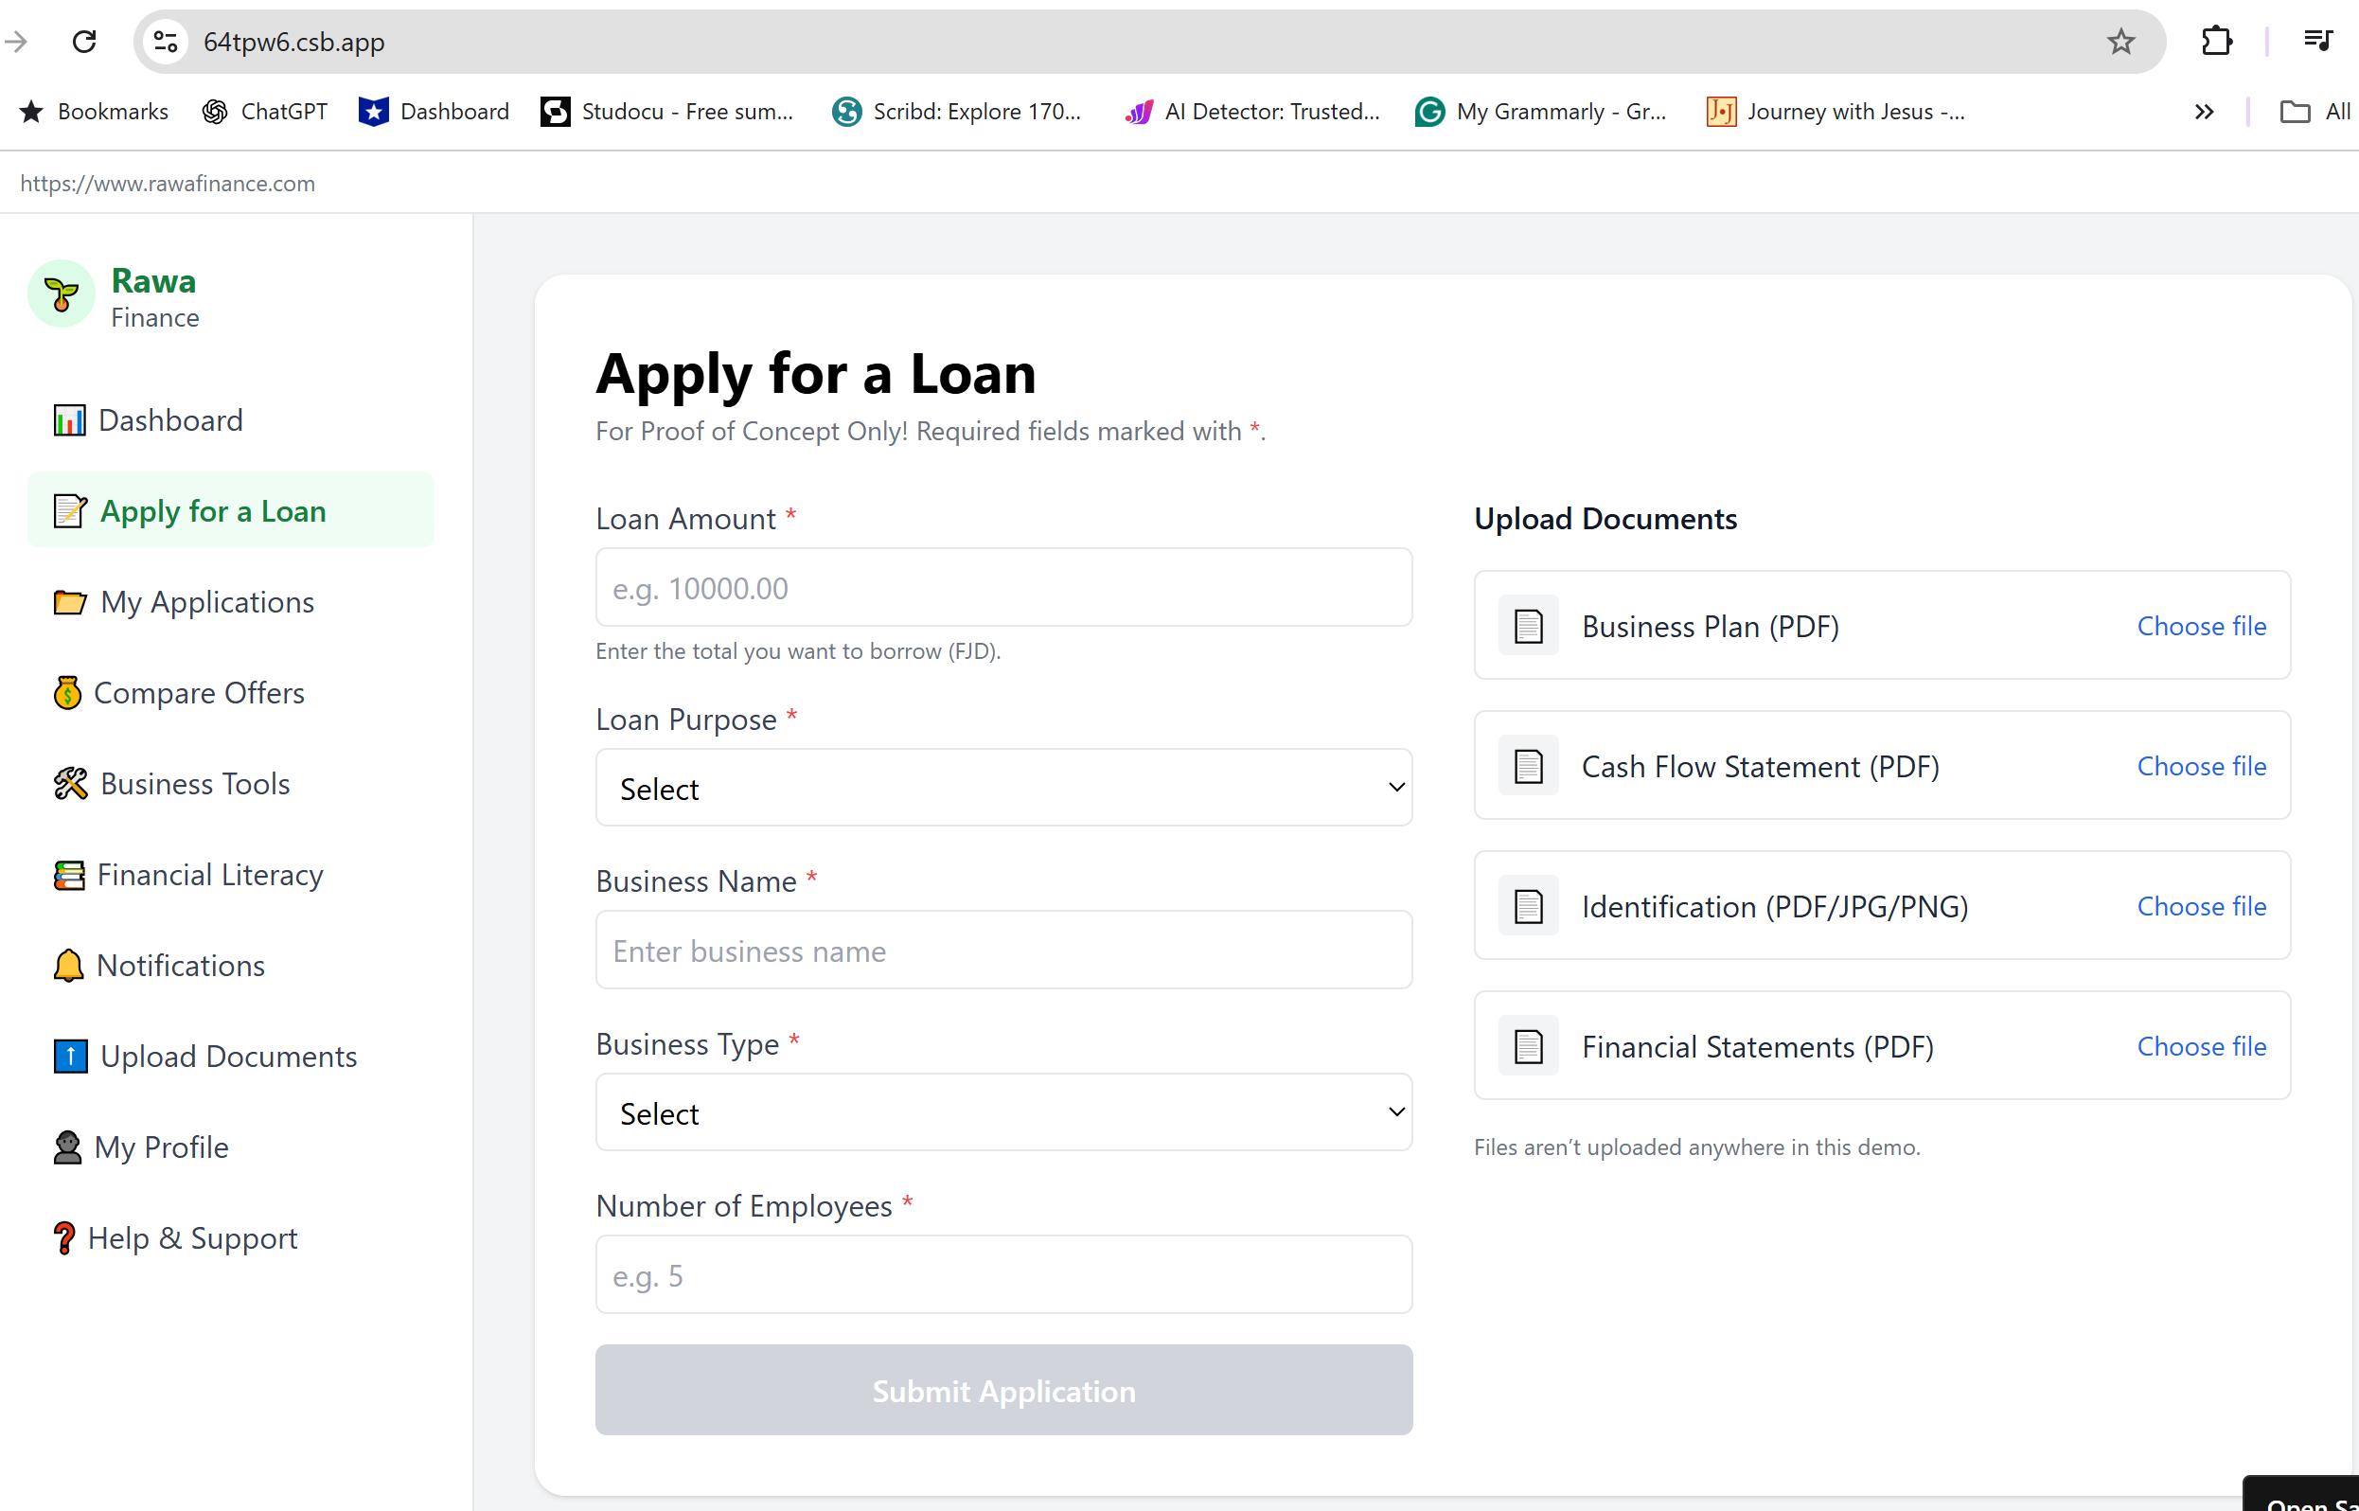
Addressing Procedural Problem
For SMEs:
One application
Multiple loan offers
Plans & forecasts
For Lenders:
Access qualified leads
Automate docs
Notes:
The good news: the tools are here.

Slide 14
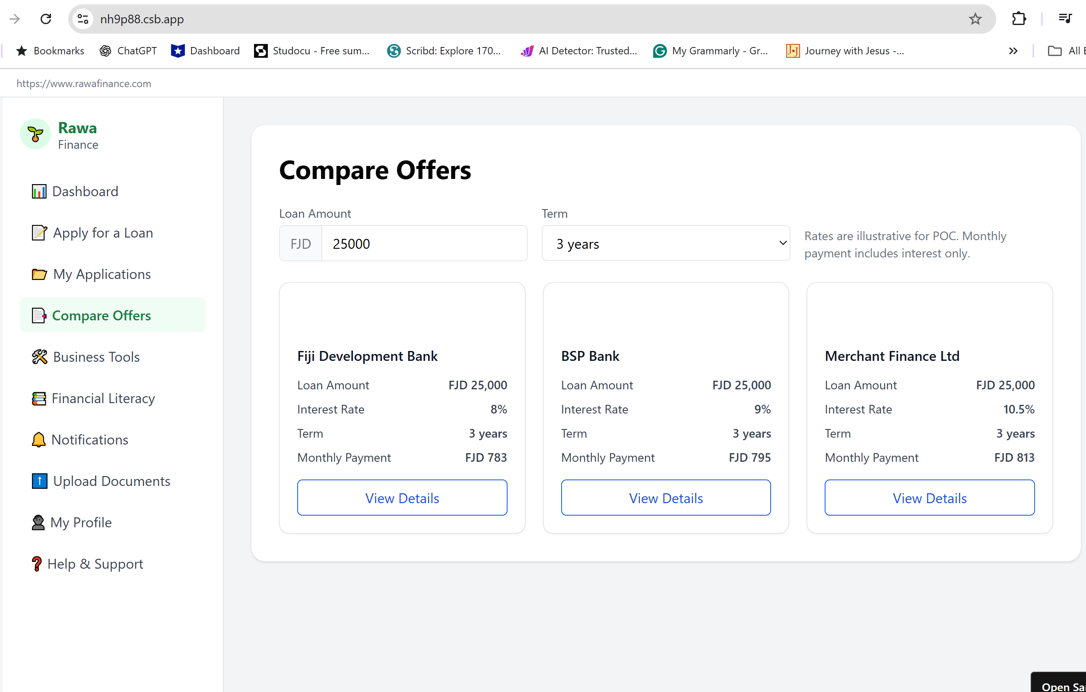
Apply → Compare → Select
a B2B2C
Digital
Lending Marketplace
Notes:
Imagine this.
An SME applies once.
They compare options instantly.
They select what works for them.
This is a digital lending marketplace.

Slide 15
3
Data is Critical, Especially for SMEs

Slide 16
Addressing Structural Problem → Leverage Transactional Data
Source: Caire, D. and Fernandez Vidal, M. (2024) Leveraging transactional data for micro and small enterprise (MSE) lending.

Slide 17



Credit Scoring Model Transformation
Applies for loan
Credit score
MSME
Platform
lender
transaction data
partnership
Notes:
FundFina

Slide 18
4
Business Model
Must Adapt

Slide 19
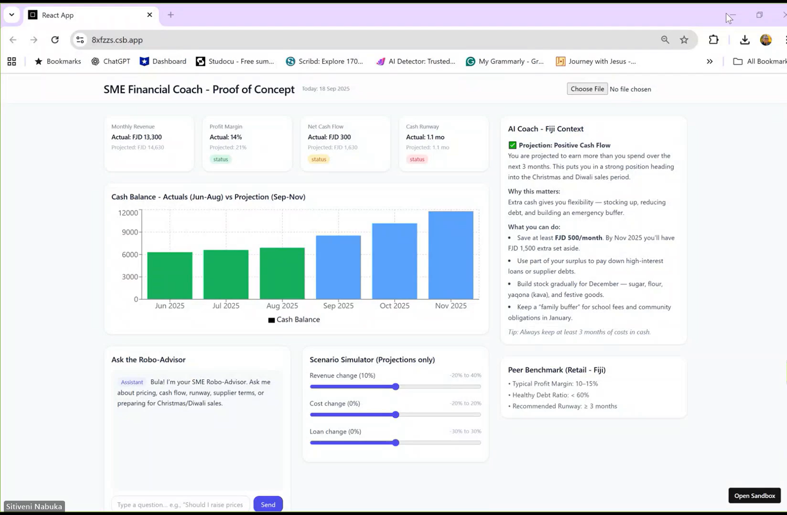
Putting It All Together → Business Model Must Adapt

Slide 20
What’s Next?

Slide 21
Frameworks Are In Place (mostly)
Transforming Fiji into an innovative, cyber resilient, and digitally empowered society
Automation and AI
MSME
Policy Framework
National Financial Inclusion Strategy
Fiji National Digital
Strategy
Fiji’s National
E-Commerce Strategy
Access to Business Funding Act
People and Partnership

Slide 22
The SMEs are Ready!
Source: MSME Survey Results, June 2025

Slide 23
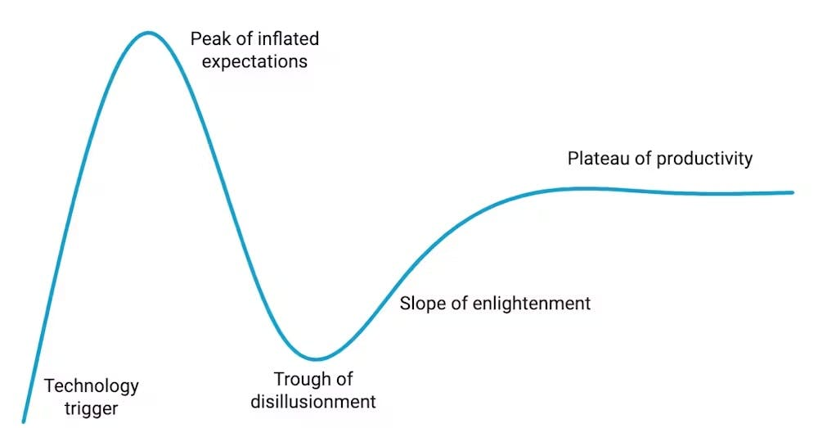
But where are IT Professionals in the Hype Curve?

Slide 24
“
Pacific SMEs are not behind, they are right on time -
but technologists must bridge the hype to productivity.

Slide 25
“
We are called
to Action and
to Reshape Industries
Dr Isimeli Tagicakiverata
18th September 2025 @ NCIT 2025

Slide 26
Vinaka Vakalevu

Slide 27
