Slide 1
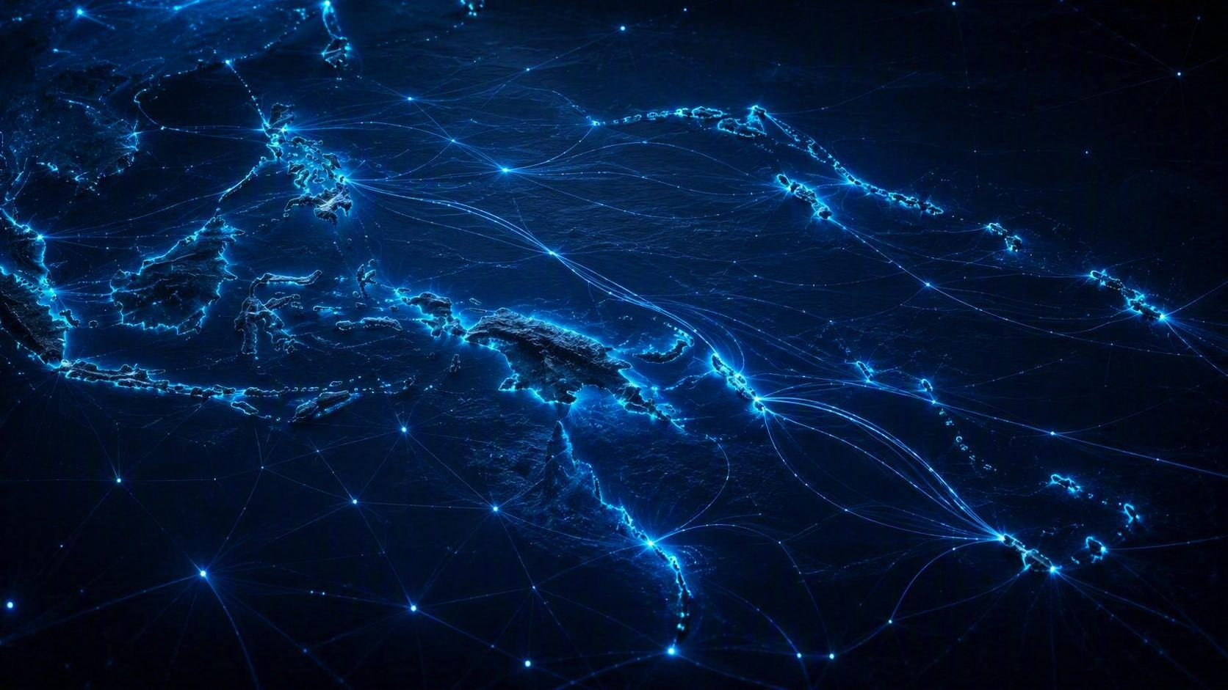

AI-ENABLED
CYBER THREATS
The Pacific's Growing Invisible Attack Surface
Prashil Kumar
CEO / CISO — CYBER ACADS

Slide 2
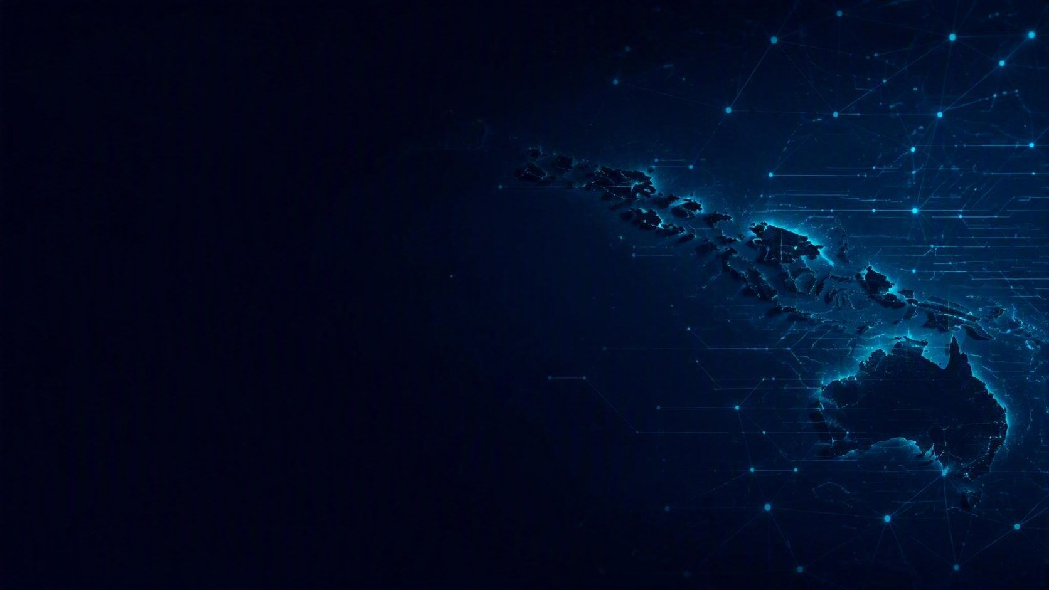
THE REALITY ON GROUND
1
One Role, Many Hats
2
Budget Limitations
3
Cybersecurity is IT's Problem
4
Migration / Loss of Skilled Resources
5
Practices
✓
Documentation
✕

Slide 3
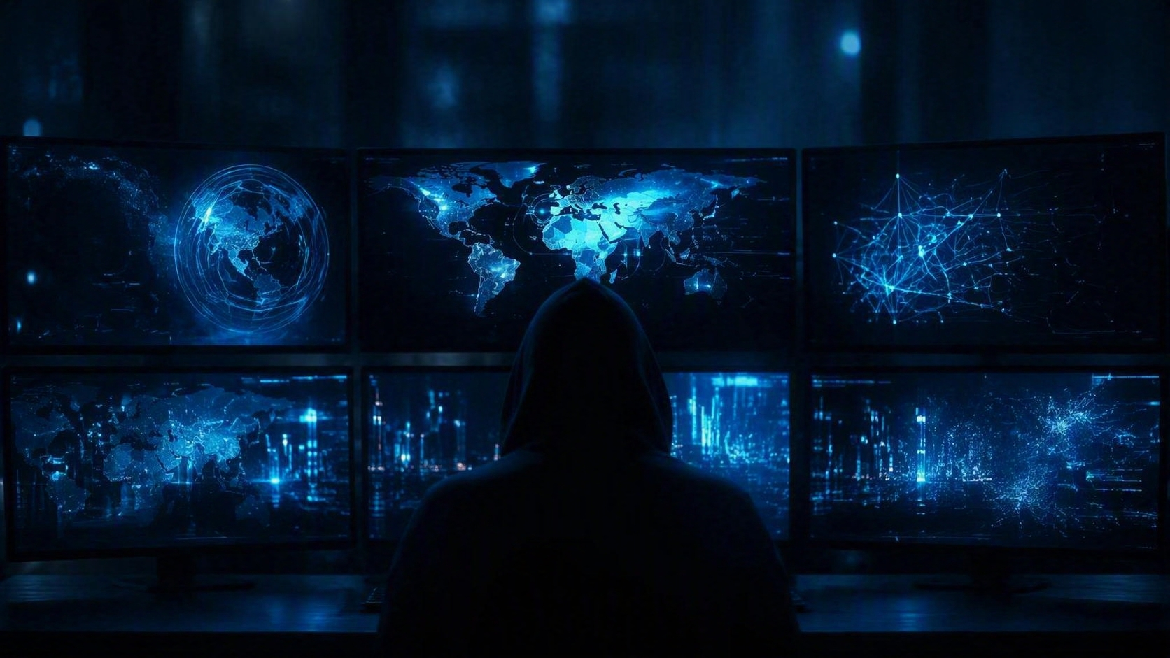
ATTACKERS DON'T CARE

Slide 4
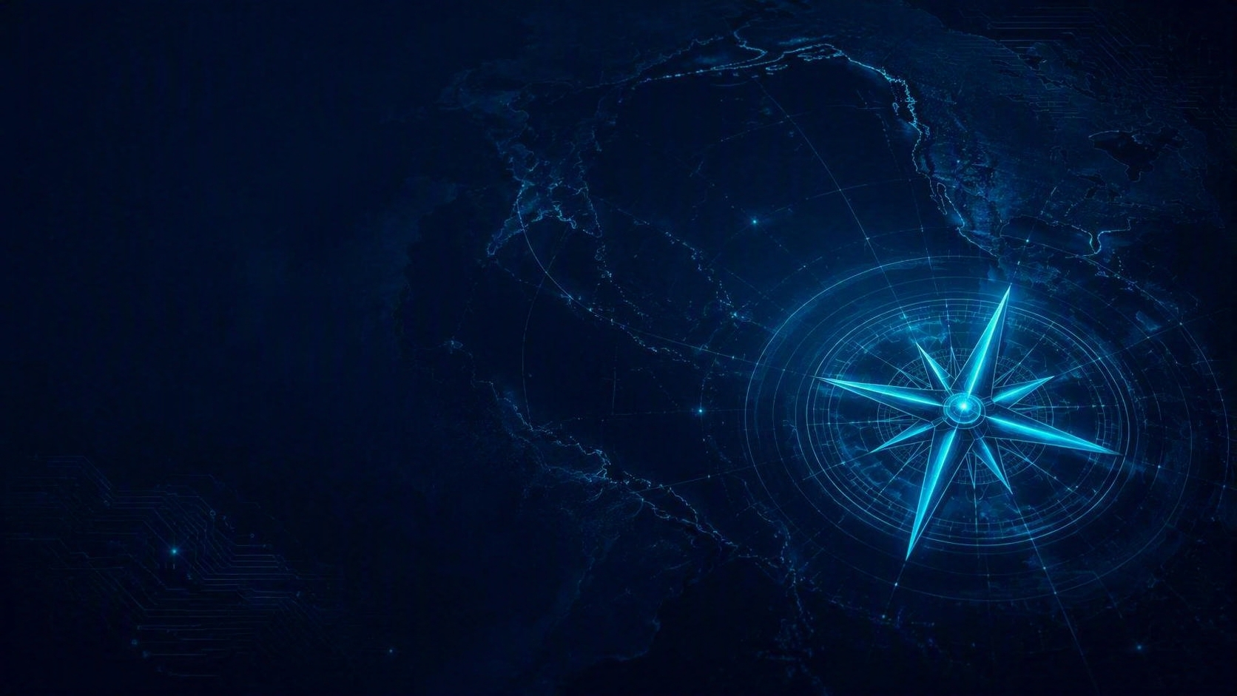
NAVIGATE THE CHALLENGE
1
Prioritize According to Business Risks and Strategy
2
Understand and Act per Current Threat Landscape
3
Communicate Risks to Executives
4
Rome wasn’t built in a DAY!!

Slide 5
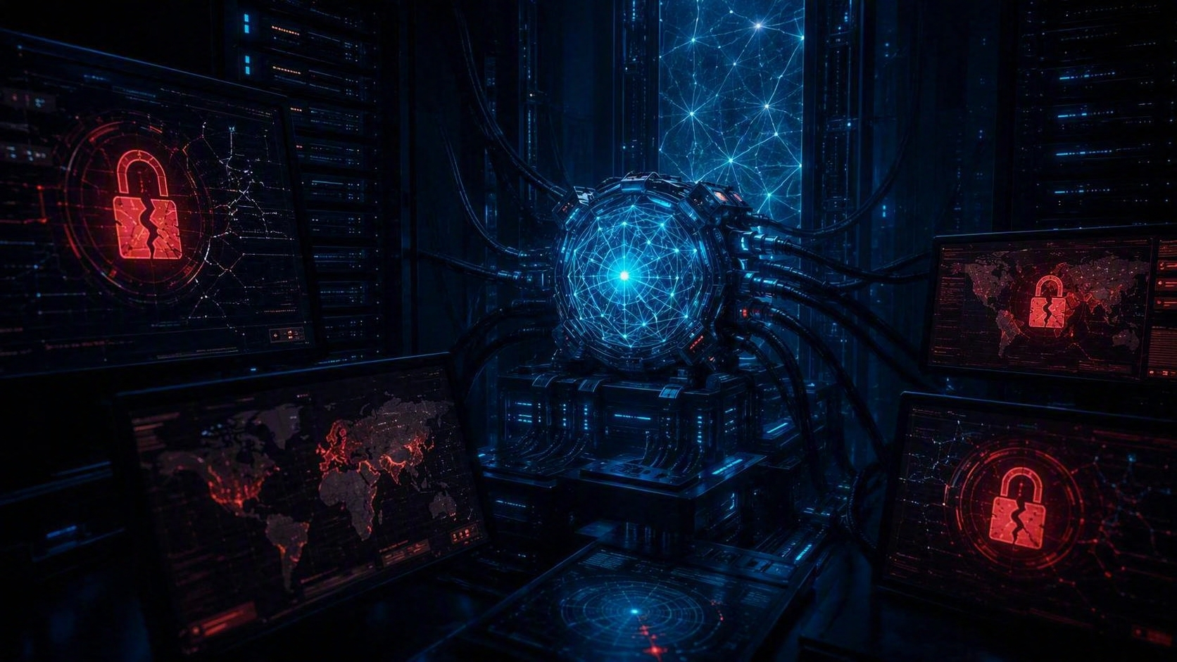
AI RISKS
AI-POWERED EXPLOITATION

Slide 6


WORK SMARTER NOT HARDER
REDUCE YOUR ATTACK SURFACE

Slide 7
REDUCE YOUR ATTACK SURFACE
1
Decommission Legacy OS / Services
2
Geo-block
3
Consolidate Vendors
4
Reduce Internet-Facing Environments

Slide 8
GET AHEAD
1
Run Continuous Attack Surface Scans
2
Subscribe to Free / Cost-Effective Threat Intel
3
Be Prepared for WHEN
IRP • Immutable / Offline Backups • Tested BCP/DR
4
Build Your Human Firewall
5
Cyber Insurance

Slide 9
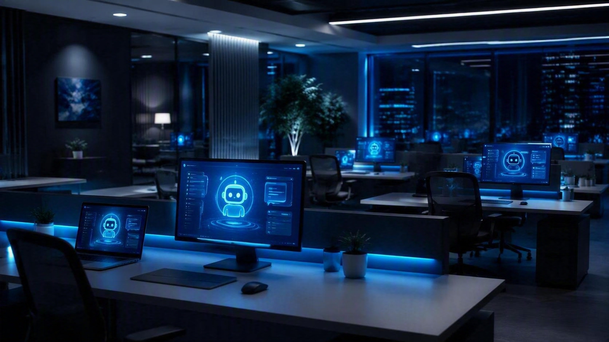
AI RISKS
DATA LEAKAGE

Slide 10
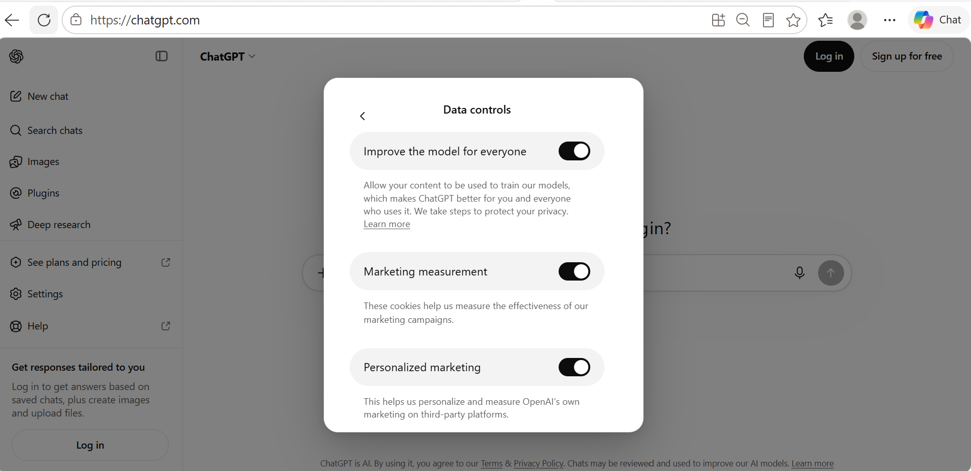
THE DEFAULT SETTINGS

Slide 11
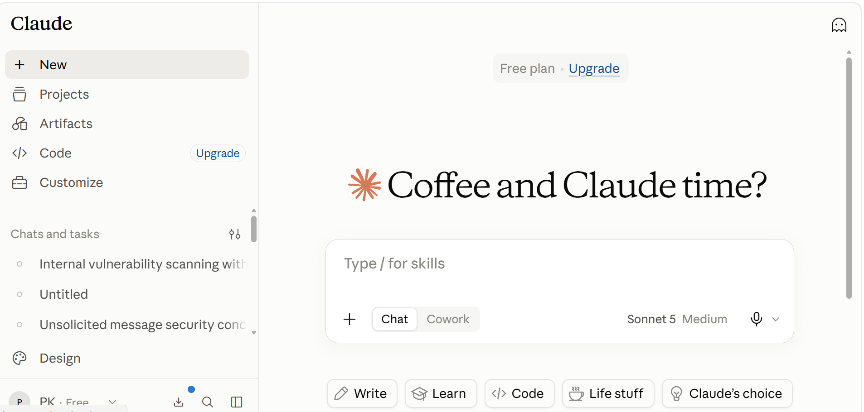
MY CLAUDE EXPERIENCE

Slide 12
ADDRESS CHALLENGES
1
Inventory AI Tools Used
2
Limit or Kill Unsanctioned Apps
3
Endorse AI Responsible Use Policy
4
Conduct AI Risk Trainings
5
Explore Existing Security Solutions
6
Budget for Sanctioned AI Apps

Slide 13
VINAKA VAKALEVU
THANK YOU • QUESTIONS?
CONTACT US
info@cyberacads.com
+679 990 5497

