Slide 1
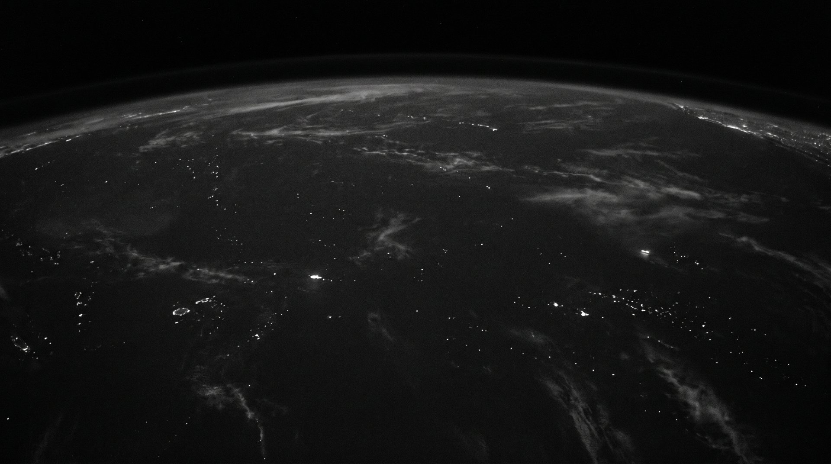

AI NATIVE NETWORKING
Donald Hough · Director of Enterprise Solutions
Notes:
Walk to centre. Plant feet. One beat before speaking. Bula vinaka.

Slide 2
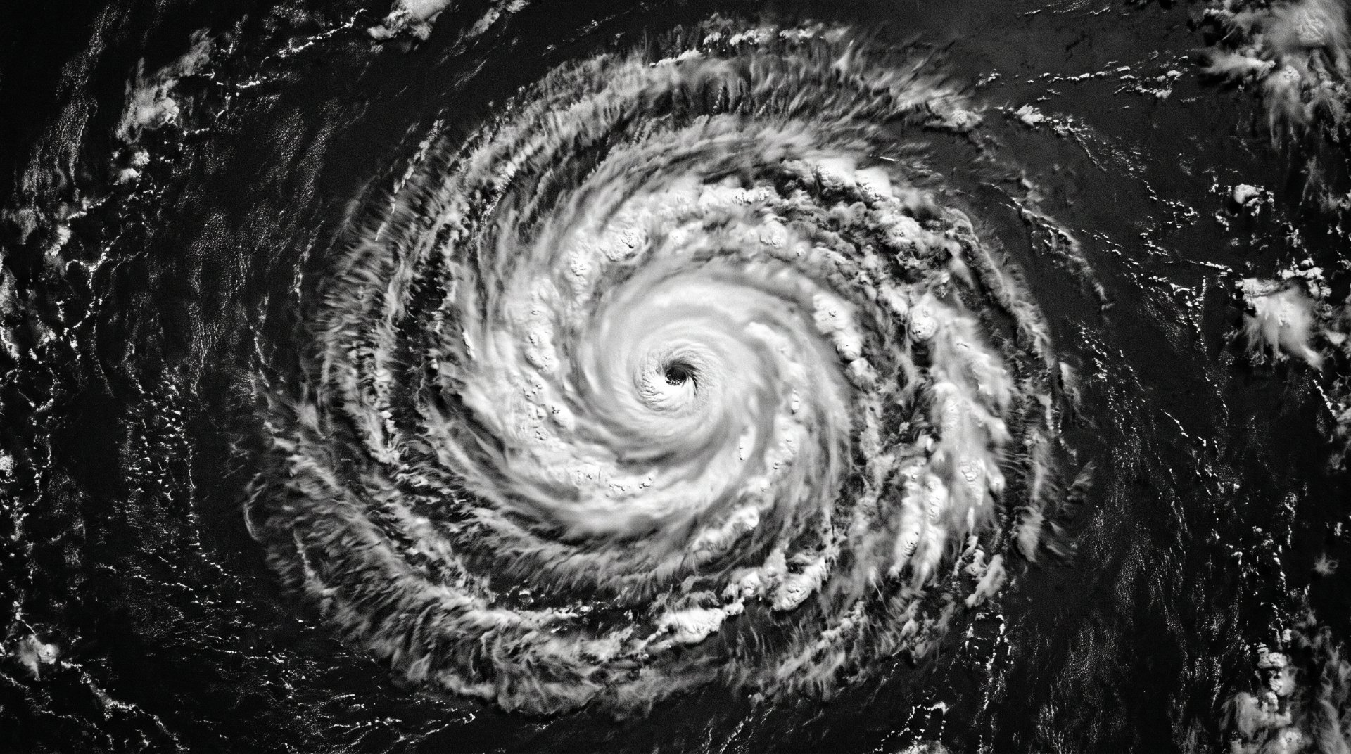
ONE NIGHT, FOUR BEATS
02:00
Surge floods a fibre segment off the Koro Sea.
02:04
Traffic has already rerouted itself.
Nobody fixed it. That's the point.
02:10
The clinic and the bank are protected first.
Sunrise
One ticket, root cause included. The network wrote it.
Your engineer was at home, asleep, the whole time.
Notes:
Walk the four beats — the storm, the reroute, the clinic and the bank, the ticket at sunrise. Your engineer was asleep the whole time. Then let the line sit; this slide holds for ~90 seconds.

Slide 3
MOST OF THE MARKET
WHAT WE MEAN BY AI NATIVE
BOLTED ON
BUILT IN
AI added afterwards
Designed for machine reasoning
Same old dashboards
Telemetry from day one
Human is the first responder
Human is the escalation point
Notes:
Every datasheet says AI-powered. Most of it is AI bolted on. A smart speedometer on a horse.

Slide 4
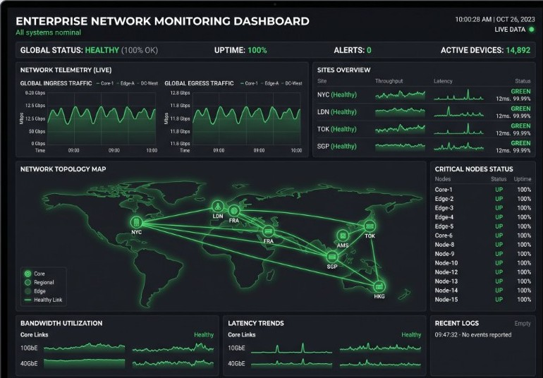
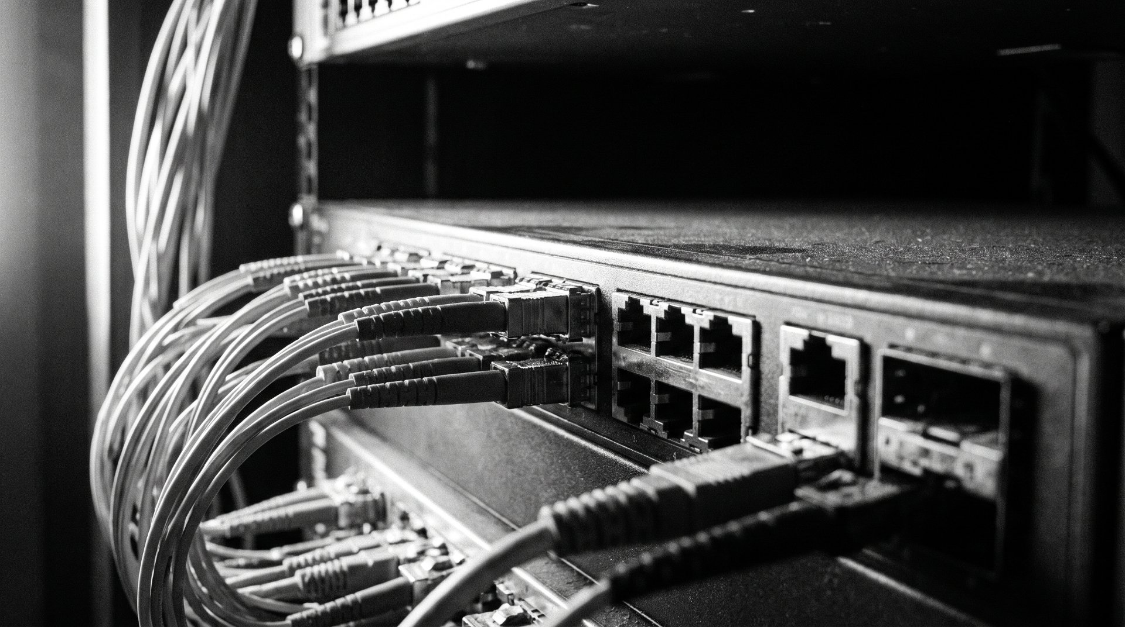

TWO FACES
You need both to see the whole picture.
AI RUNS THE NETWORK
THE NETWORK RUNS AI
02:00
it acts without paging anyone
<5ms
on site, not 70ms to Sydney
1
ticket, root cause included
0km
customer data leaves Fiji
Notes:
Two faces, and you need both. Face one: AI running the network — the next slide unpacks it. Face two: the network running AI, inference happening on site instead of 3,000km away in Sydney.

Slide 5
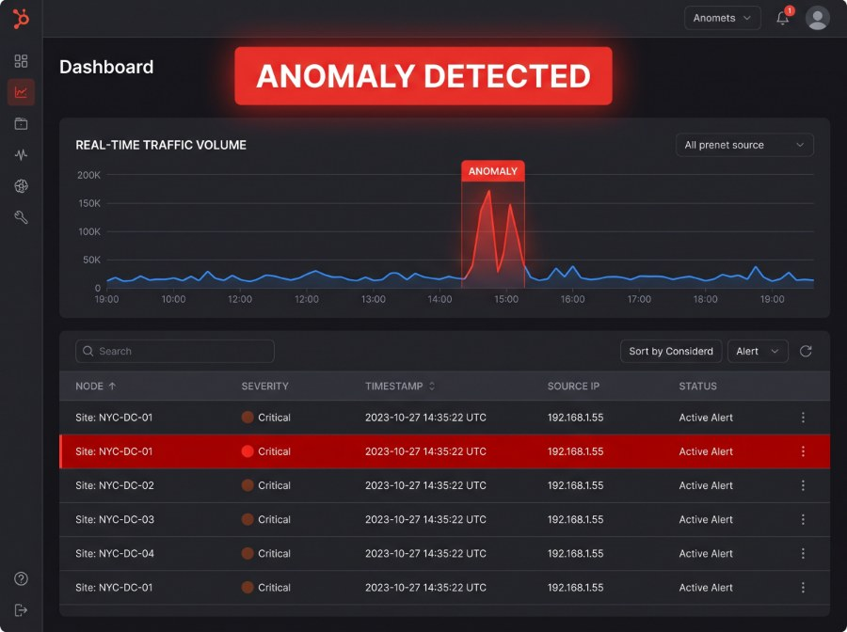
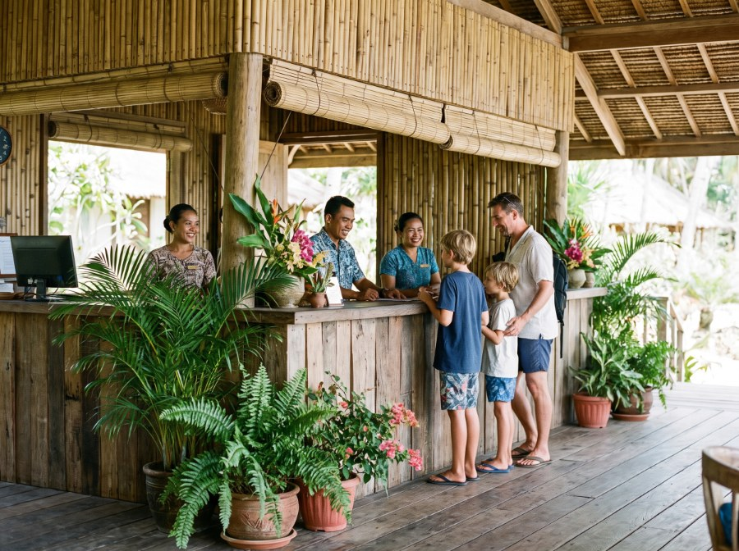
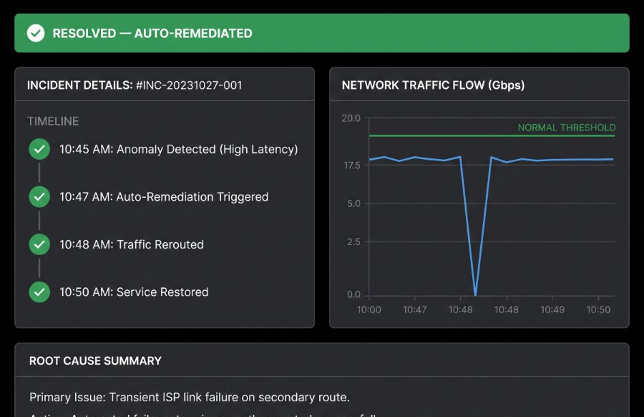






AI runs the network.
STREAMING TELEMETRY
ANOMALY DETECTION
INTENT-BASED OPERATIONS
SELF- HEALING
These models can be deployed for this service today
Notes:
Four upgrades. Intent-based is the one I'd single out — the resort GM doesn't care about VLANs. And the reasoning runs on open models we can host here: Llama, Mistral, Qwen, DeepSeek, Gemma.

Slide 6
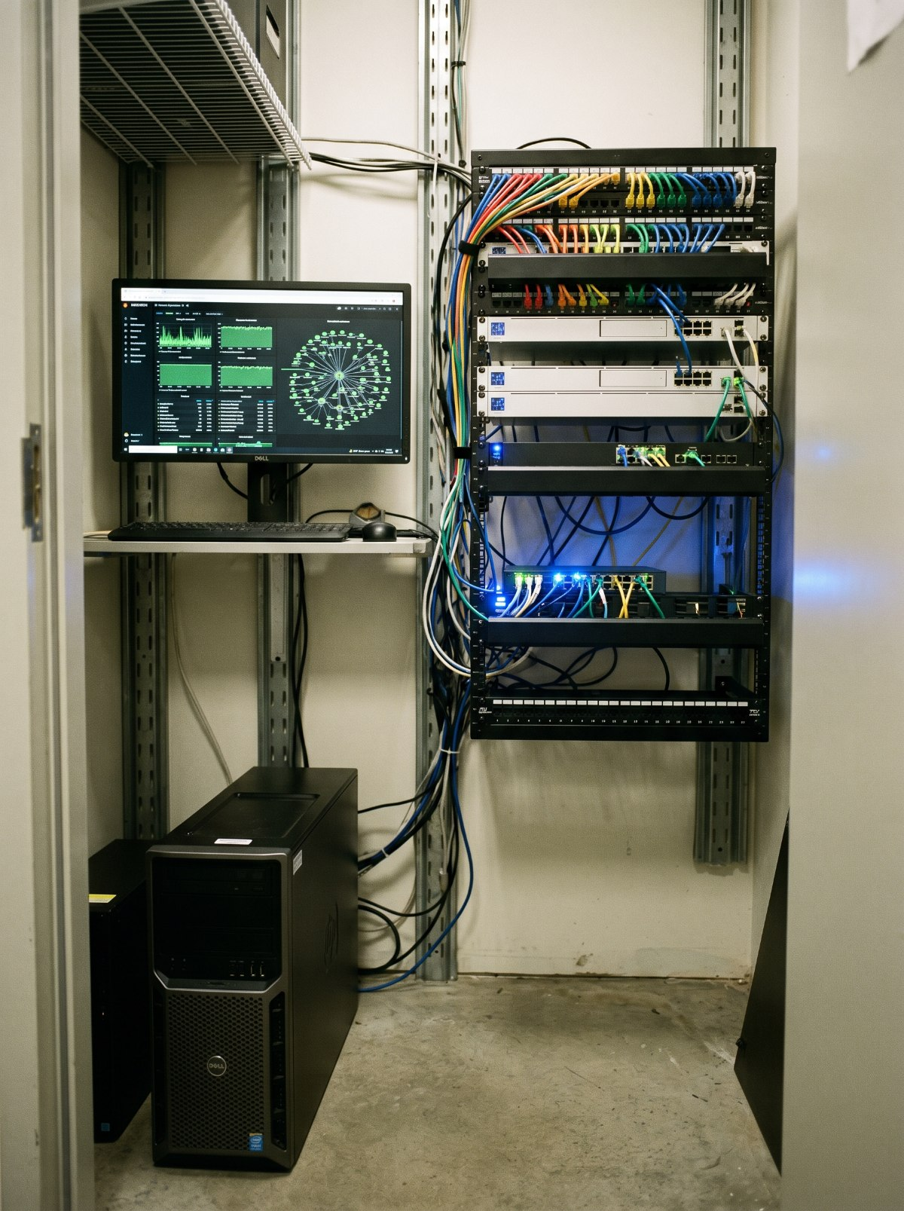
WHAT A NODE LOOKS LIKE
No data centre required.
GPU
16GB NVIDIA or larger
MEMORY
64GB system RAM
CPU
Recent 8–16 core
30
output tokens per second — one interactive session on an 8B model
Add nodes per site — not cloud contracts.
Notes:
People assume this needs a data centre. It does not. One interactive session on an 8B model at 30 tokens per second runs on a serious workstation — a 16GB NVIDIA card, 64GB of RAM, a recent 8 to 16 core CPU. That is a box we can build, ship and service from Suva. Scale by adding nodes per site, not by signing cloud contracts.

Slide 7
You already own tools that watch. This one decides.
TOOL
WHAT IT DOES
WHERE IT STOPS
SIEM
Collects and correlates the logs
A human still reads the dashboard
NDR
Flags the traffic that looks wrong
Hands you an alert, not an outcome
SOAR
Runs the playbook you wrote
Only handles what you predicted
AI native
Reasons about faults nobody scripted
It acts, then tells you what it did
Notes:
If you already run a SOC, you will hear echoes of tools you own. The difference isn't more automation — it's that nobody wrote the playbook in advance.

Slide 8
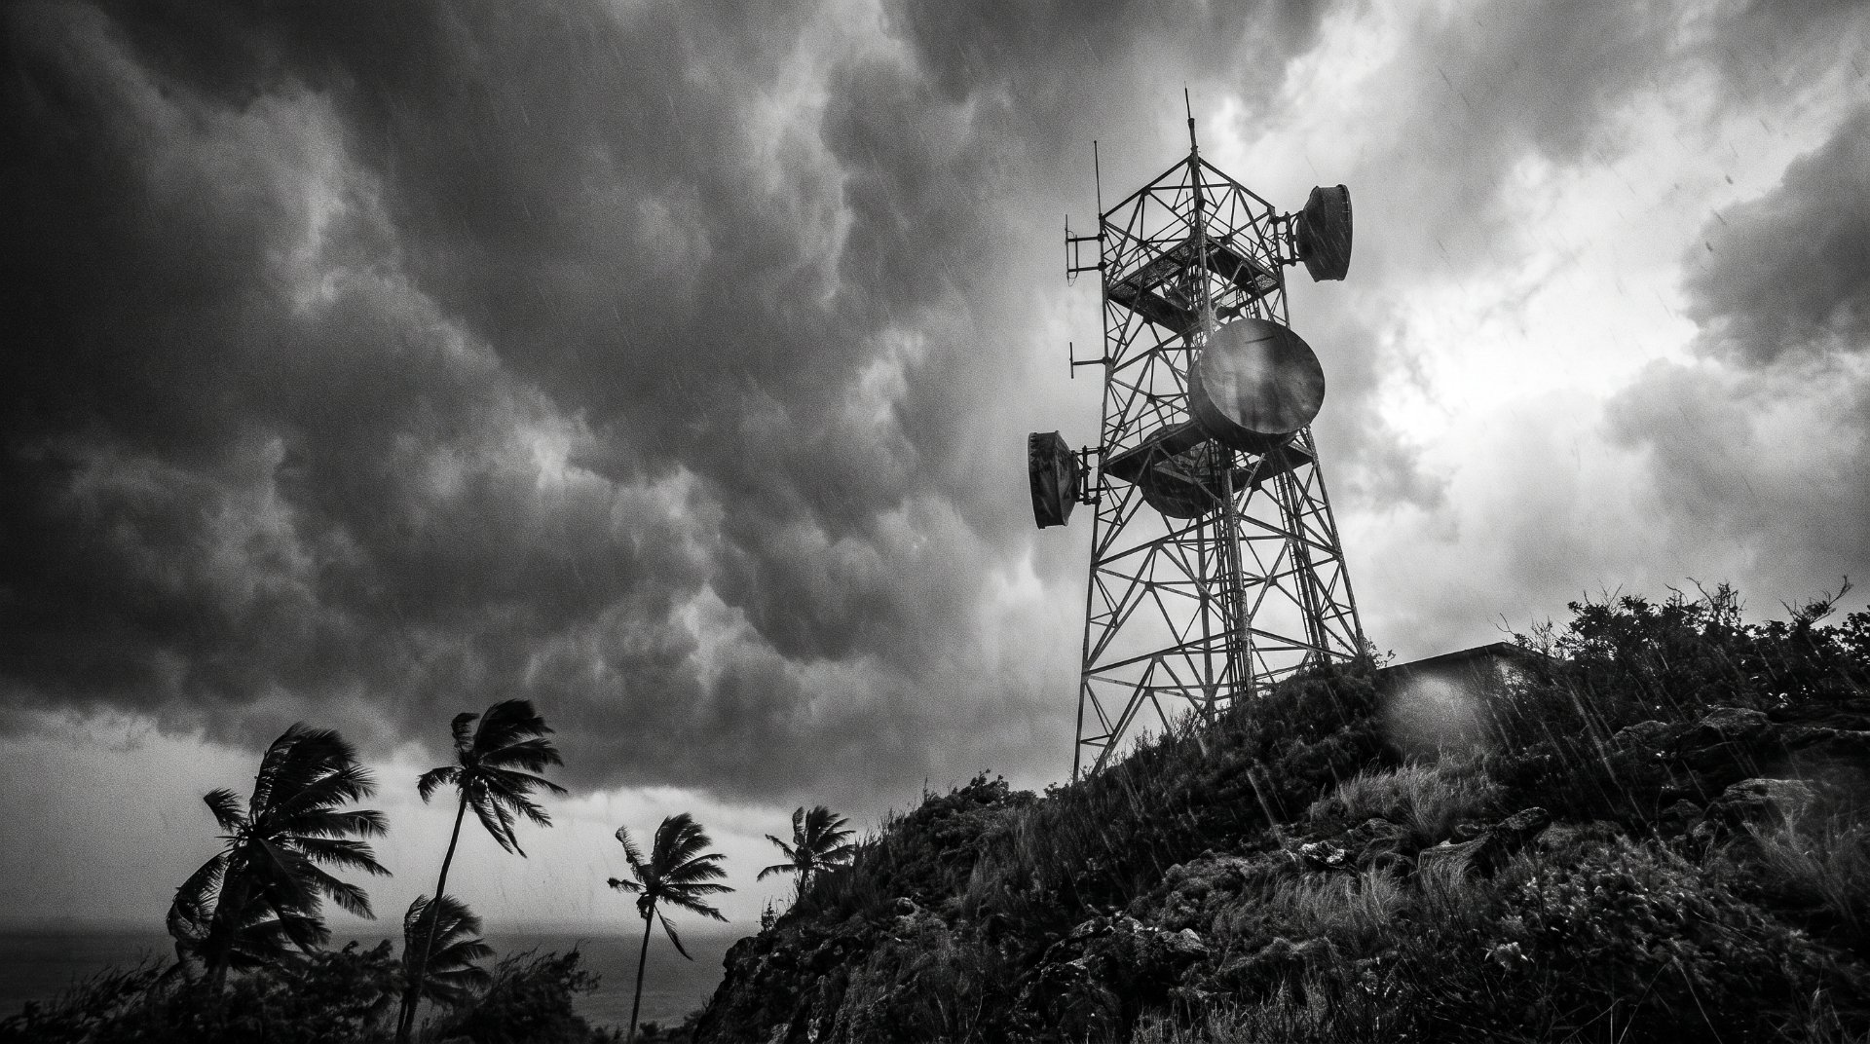
TWO REASONS
WHY THIS MATTERS MORE HERE
Notes:
Two reasons this matters more here than in Silicon Valley: the size of our teams, and the conditions our networks live in.

Slide 9
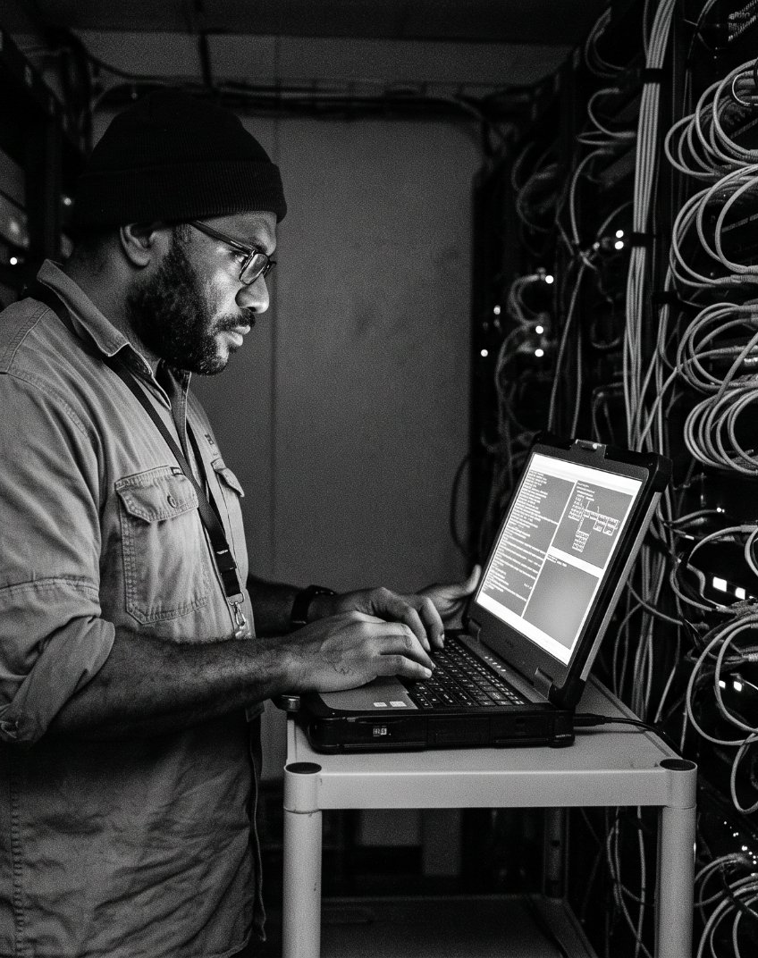
A complement, not a replacement.
Small teams here carry the whole network, the servers, and everything with a power cord.
→
AI takes the triage, the log-reading and the 2am first response
→
Your engineers keep the judgement calls, design and customer trust
→
Same team, far more network — and fewer nights lost to it
Notes:
Small teams here carry enormous scope. AI native doesn't replace that engineer — it takes the triage off them so their judgement goes where it counts.

Slide 10
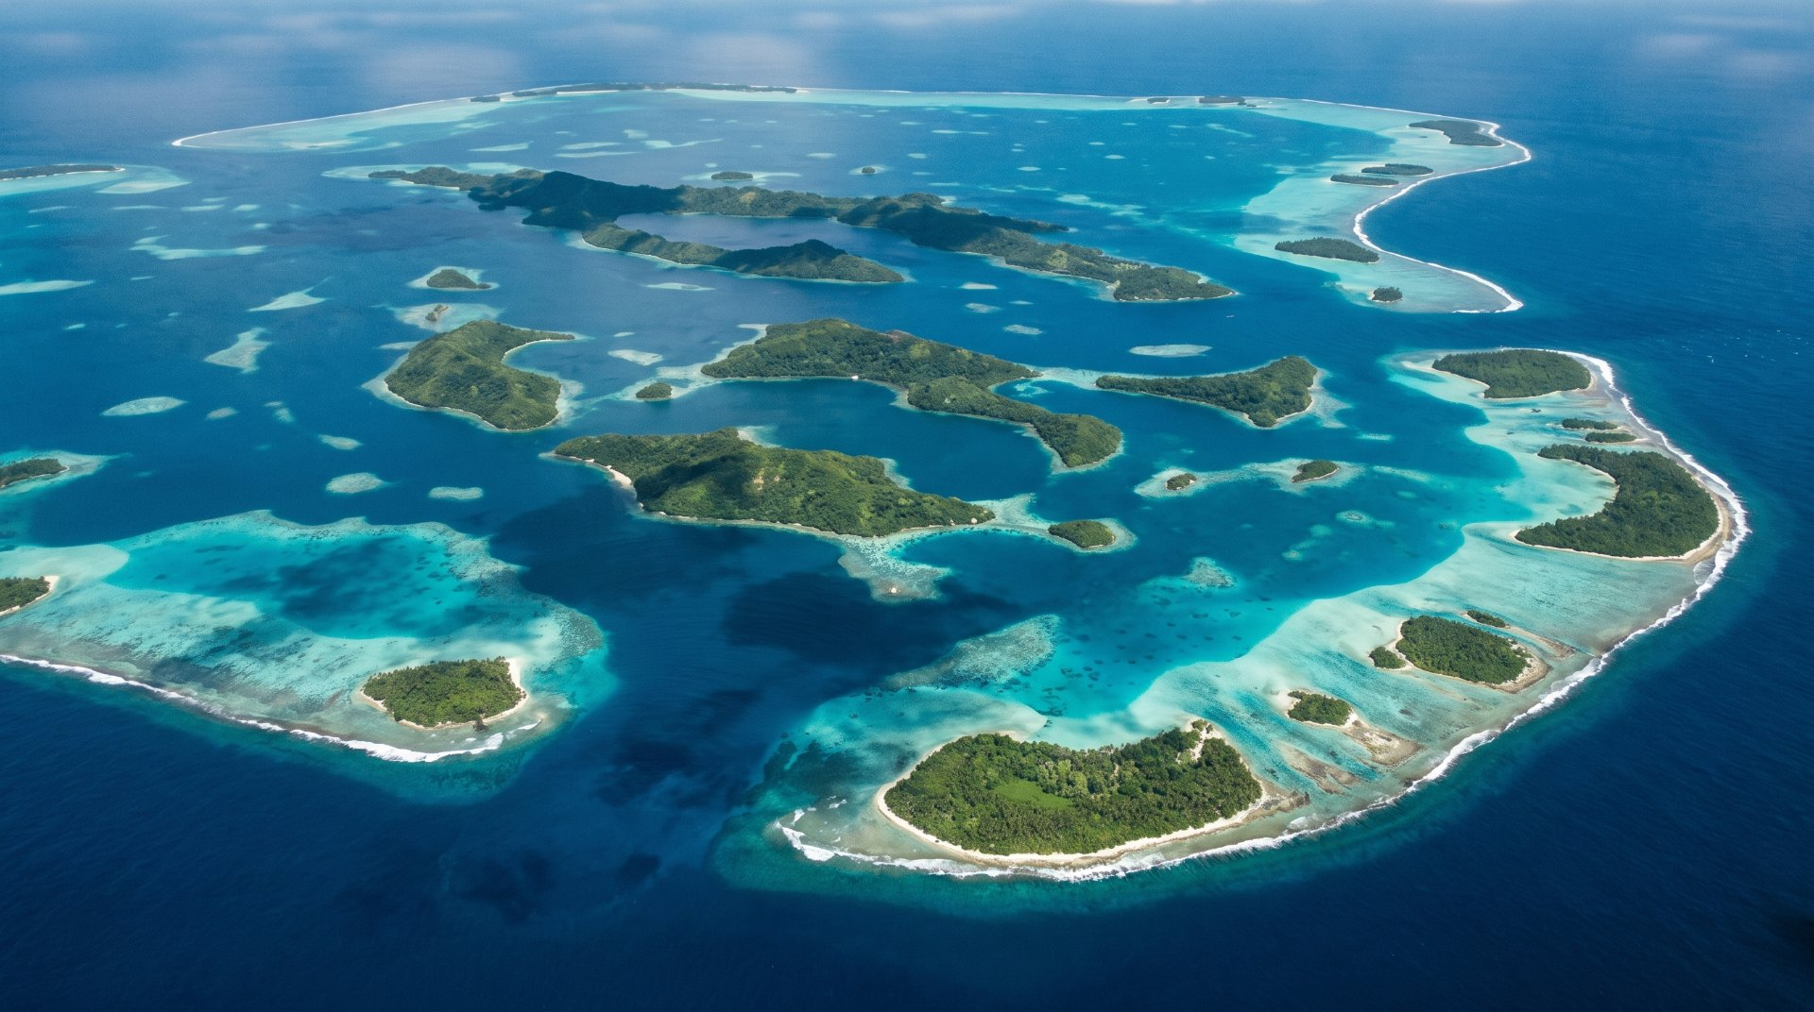
Every cyclone season is a penetration test nobody scheduled.
The people who know what's best for Fiji are in Fiji.
Cyclone-resilient, island-scale, self-healing by necessity. These problems are ours — so is the work.
Notes:
Every cyclone season is an audit nobody booked. California does not get tested this way — and the people who understand these conditions live here. That leads straight into who answers the phone at 2am.

Slide 11
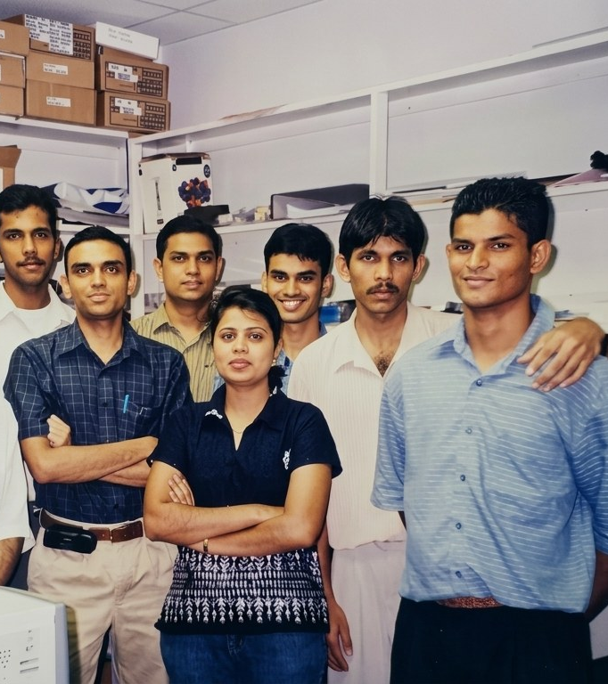

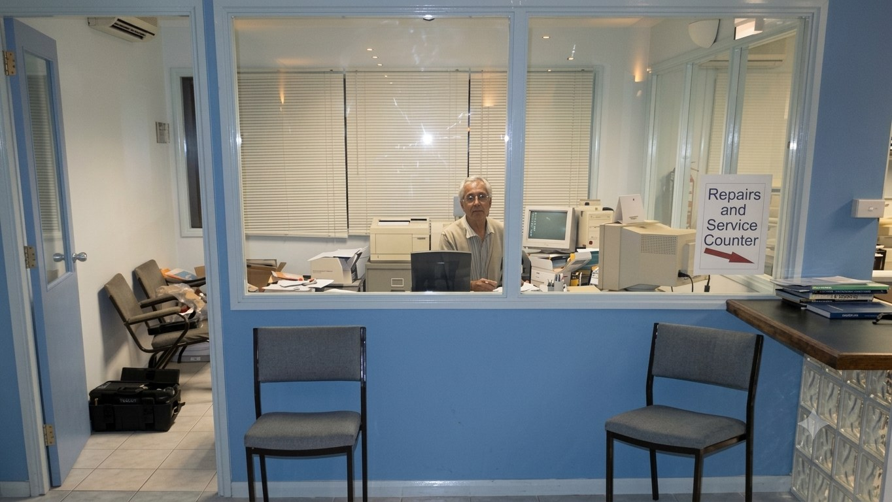
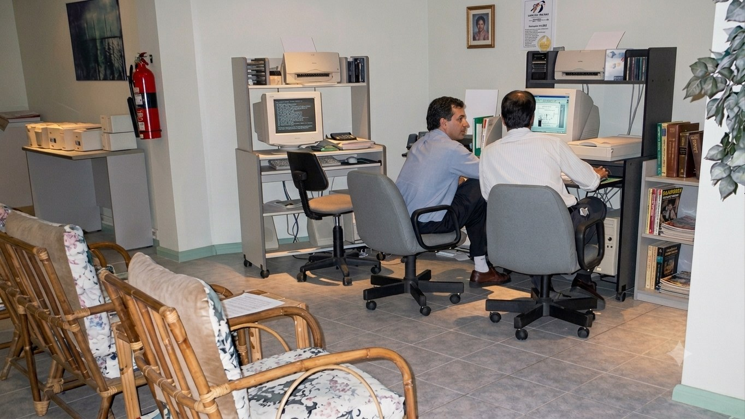
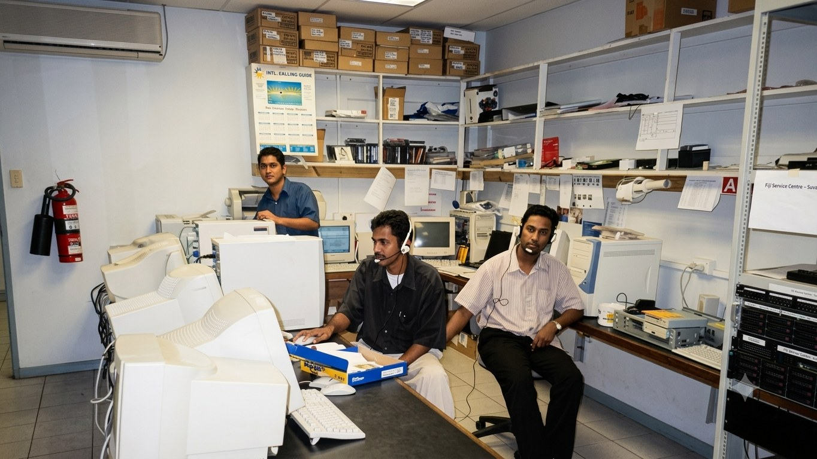
1994
One shop. One employee. Toner cartridges.
2026
Fiji's largest electronics retailer.
10 stores · 130 staff
Notes:
1994: one shop, one employee, toner. What scaled was trust — one repair ticket, one warranty at a time.

Slide 12
THREE SENTENCES I HEAR IN EVERY MEETING
"We didn't know you did that."
"We didn't know that was possible."
"We've always done it that way."
Notes:
These three sentences come up in nearly every customer meeting. The first is a gap in what people know we do. The second is a gap in what they think is possible. The third is the one that costs them money.

Slide 13


FIRST LOOK
BONDWELL FOR BUSINESS
B4B
logo in development
Registered Partner
Edge inference, built in Fiji
Notes:
A first look, not a launch. Two facts so you know it's real: Anthropic Registered Partner, and Axelera AI for edge inference.

Slide 14
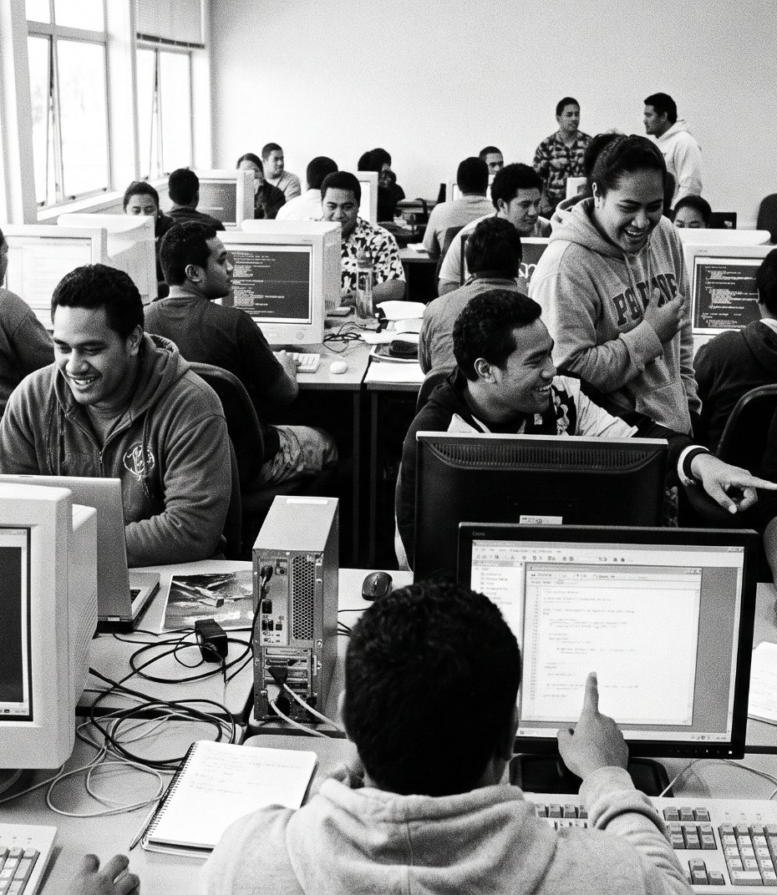
THE SEQUENCE
From exporting talent
01
Businesses adopt AI native operations
02
The national baseline rises
03
Real AI work appears here
to importing it.
04
Graduates stay. The diaspora comes home.
05
Investment follows the talent
Notes:
Every year Fiji trains good engineers, and Auckland, Brisbane and Sydney collect them. Then walk the sequence — interesting problems draw talent, trust keeps it.

Slide 15
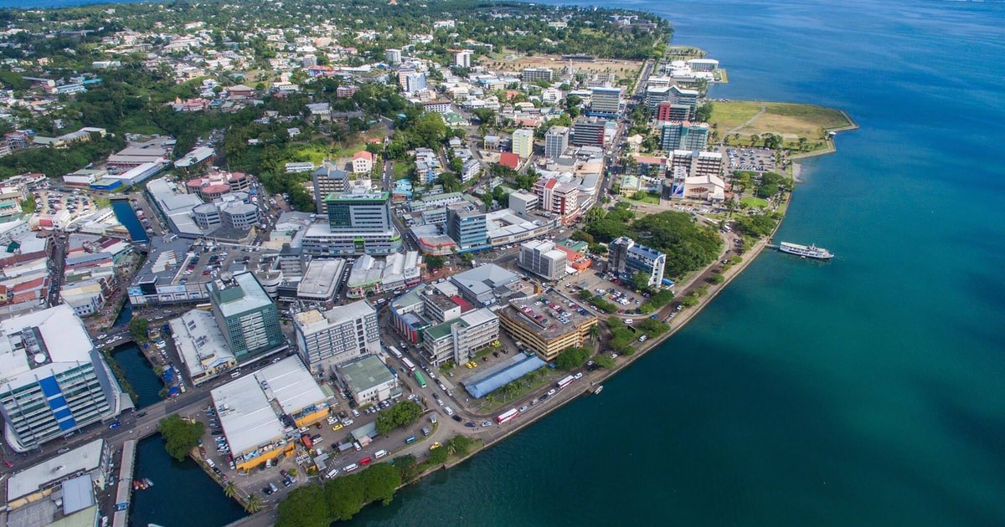
SAN FRANCISCO.
SINGAPORE.
SYDNEY.
SUVA.
It starts here.
Notes:
Four cities, four beats — slow down. Then: check your programme, this is the first AI session of NCIT 2026. And the vanua was never only the land.

Slide 16
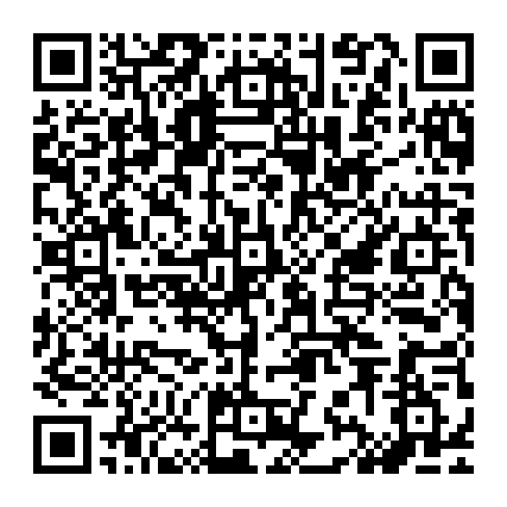
Vinaka vakalevu.
Don Hough
Director of Enterprise Solutions · Bondwell
don@bondwell.com.fj
SCAN TO SAVE MY DETAILS
992 5135
Get in touch and let's talk about what's possible.
Notes:
Point at the code — scan it and my details are in your phone. Vinaka vakalevu.

