Slide 1

AI and the Future Pacific Workforce
Opportunity, Ethics and Transformation
Irene Ireland August 2026

Slide 2
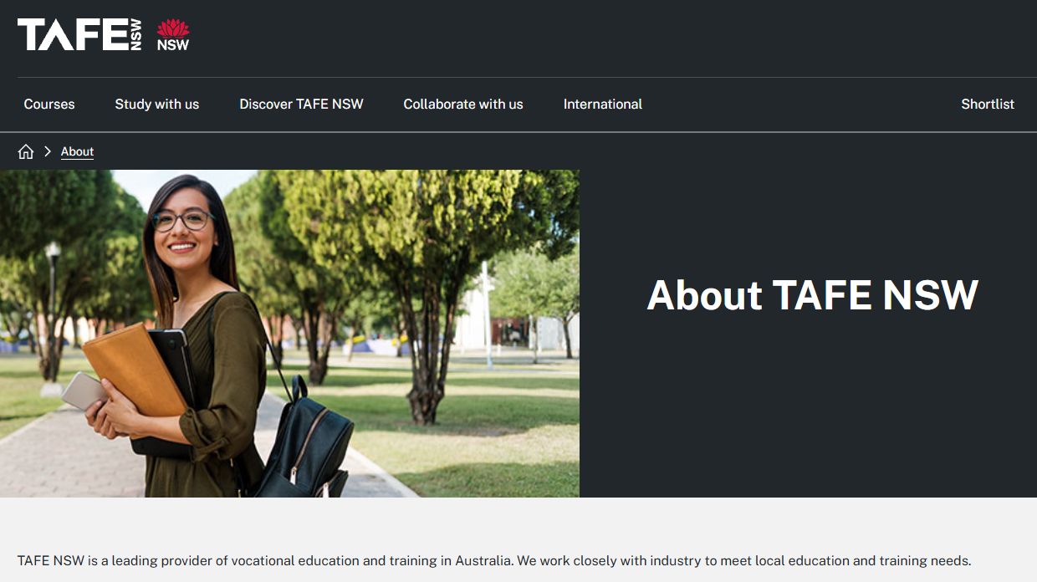

Slide 3
AI is changing work
Not replacing people

Slide 4
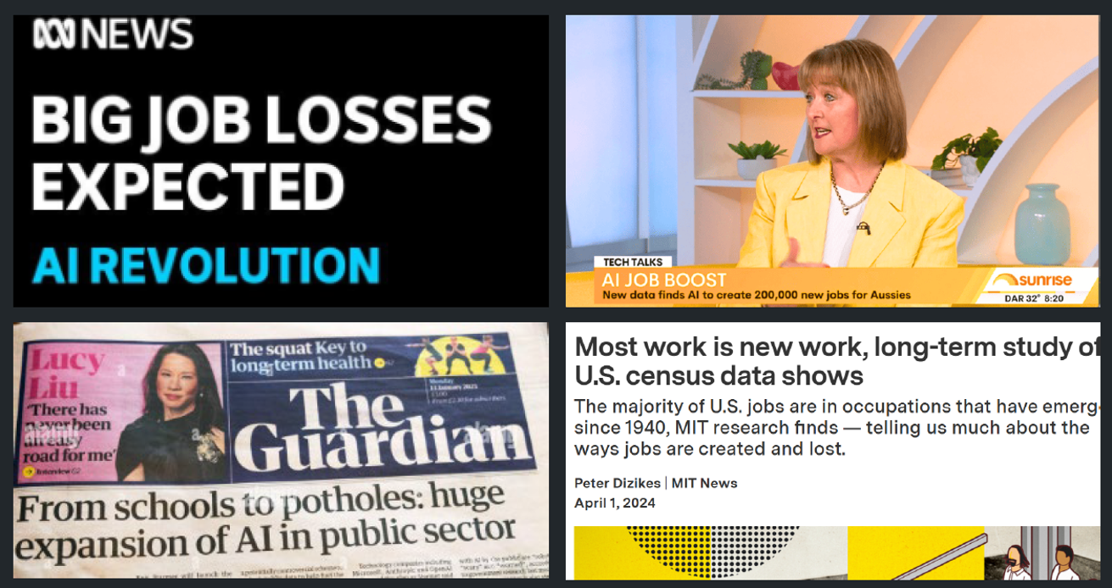

Slide 5
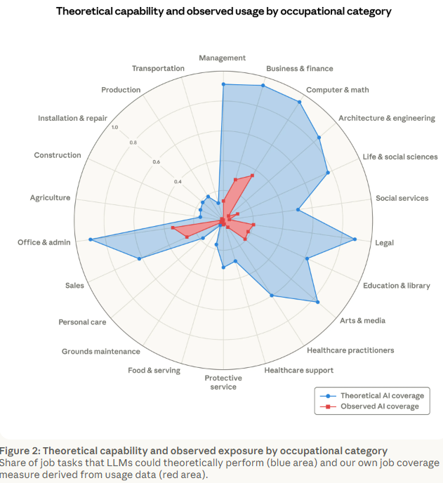
Anthropic –
Labour Market impacts of AI
Analysing displacement risk of workers
Blue = theoretical exposure
Red = observed real world usage
Jobs with higher observed coverage predicted to grow less
Limited evidence AI is impacting employment so far
https://www.anthropic.com/research/labor-market-impacts

Slide 6
AI Governance
Trust before Technology

Slide 7
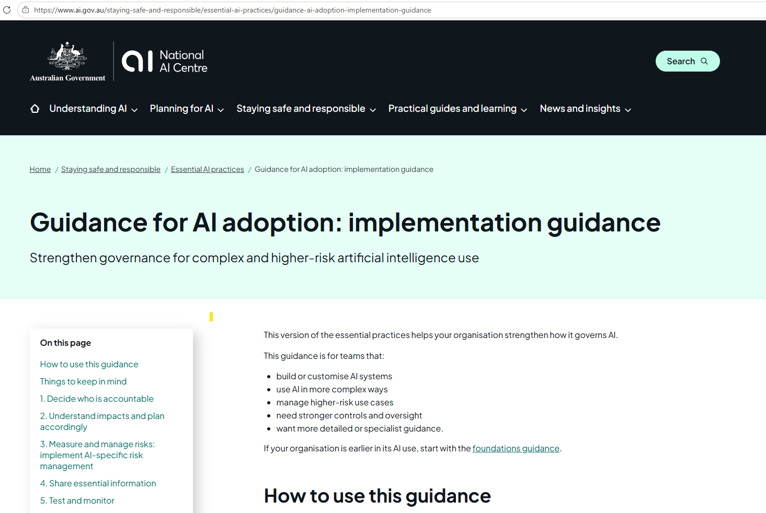
Australia's 8 AI Ethics Principles include
Human wellbeing
Human-centred values
Fairness
Privacy & security
Reliability & safety
Transparency & explainability
Contestability
Accountability
Guidance for AI adoption: implementation guidance | National AI Centre

Slide 8
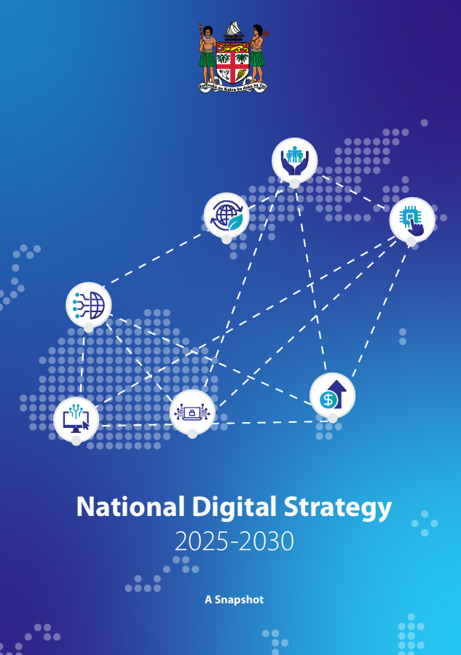
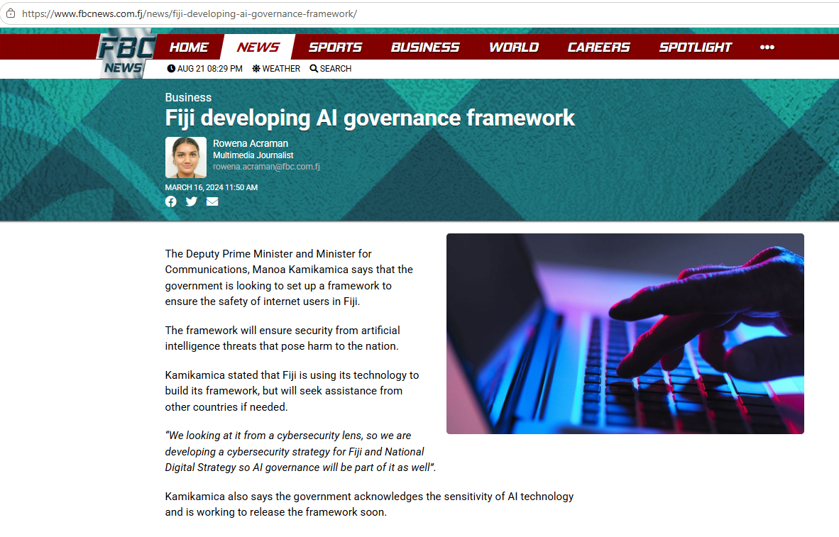
Pacific Priorities

Slide 9
Workforce Capability
The skills AI cannot replace

Slide 10
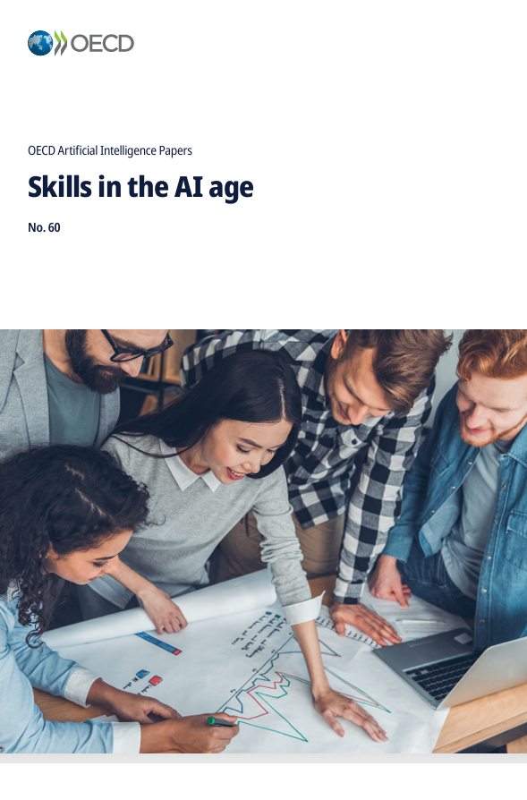
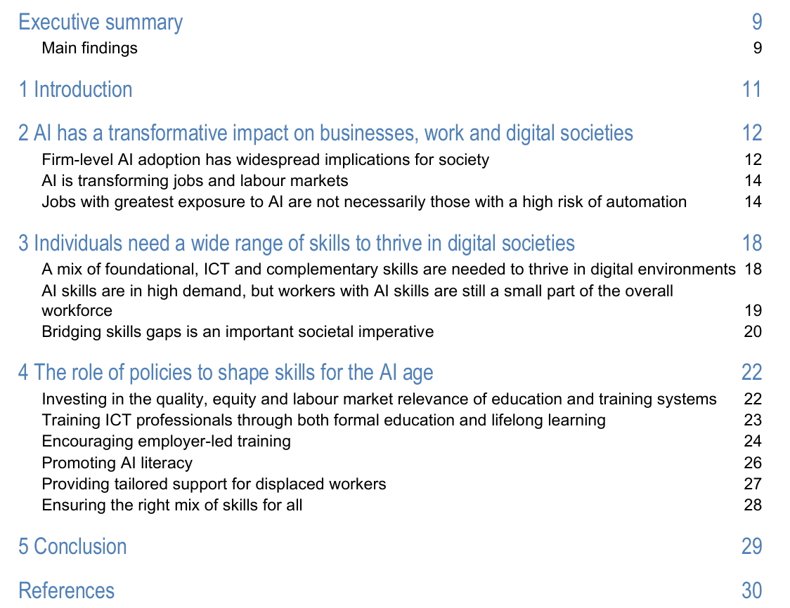
Skills in the AI age (EN)

Slide 11
TVET is the engine of workforce transformation

Slide 12
TAFE NSW and the Institute of Applied Technology Digital (IATD)
Case study
Future-focused workforce development
Industry-led curriculum design
AI integrated across learning and teaching
Digital capability embedded in qualifications
Strong partnerships with employers and technology providers
Flexible pathways from micro credentials to advanced qualifications
Examples of contemporary AI tools
Microsoft Copilot
GitHub Copilot
Power BI Copilot
Microsoft Fabric AI capabilities
Generative AI tools for content creation and problem solving
Key focus areas
AI literacy for all learners
Practical application of AI tools
Industry-relevant digital skills
Ethical and responsible AI use
Lifelong learning and workforce upskilling

Slide 13
Thank you

