Slide 1



Beyond
Connectivity
BUILDING MEANINGFUL DIGITAL ACCESS FOR PACIFIC COMMUNITIES
PRESENTED BY: VIGNESHWARAN NAIR [HEAD OF PRODUCTS - TELECOM FIJI]
A TELECOM FIJI PRESENTATION | 2026
NATIONAL CONFERENCE ON INFORMATION TECHNOLOGY | FNU

Slide 2

Part 1:
Connectivity Landscape Today
Part 2:
Connectivity with Telecom Fiji
Part 3:
Building Resilient Networks
Today's Agenda
Part 4:
Future of Connectivity
A TELECOM FIJI PRESENTATION | 2026
NATIONAL CONFERENCE ON INFORMATION TECHNOLOGY | FNU

Slide 3

Connectivity Today
“Technology is best when it brings people together."
  The internet has become a vital necessity, connecting people globally. It now shapes how people live, work, and communicate every day.
  Over 6.12 billion people, or 73.8% of the world, are online today. That number is on track to pass 75% by the end of the year.
  Smartphones and smart devices keep people constantly connected. They now make up roughly 89% of all mobile handsets in use.
  Hyper-connectivity is reshaping education, culture, and business. AI is now part of that shift, with over 4 billion adults using it monthly.
- Matt Mullenweg, founder of WordPress
A TELECOM FIJI PRESENTATION | 2026
NATIONAL CONFERENCE ON INFORMATION TECHNOLOGY | FNU

Slide 4
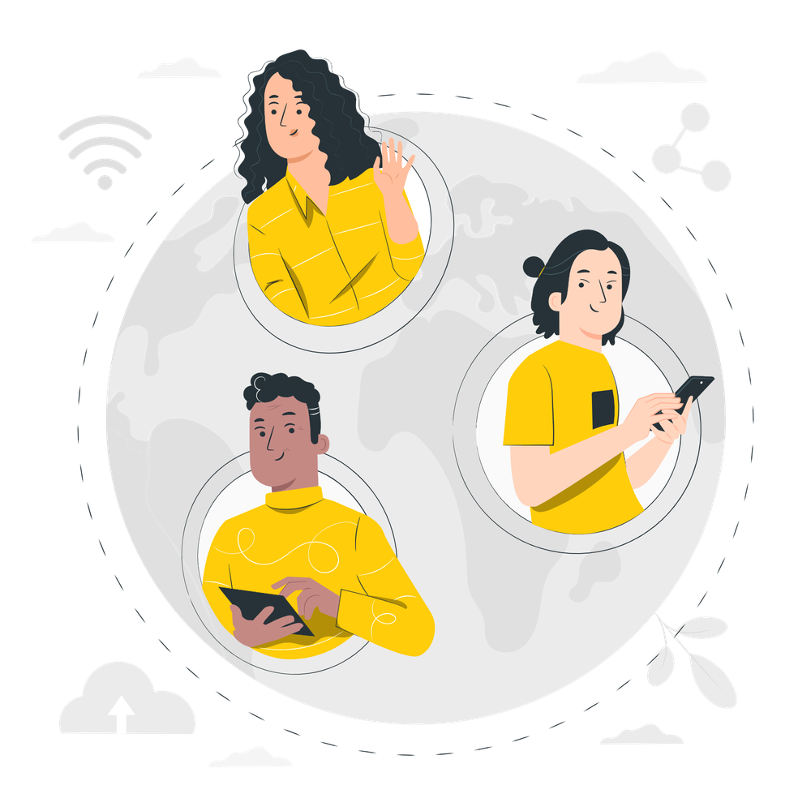
Internet Around the World
01
02
Approximately 6.12 billion people are online worldwide
5.83 billion people connect via mobile devices
The global internet population grew by 59 million users in the 12 months leading up to April 2026.
Mobile remains the primary gateway to the internet, with smartphones making up 89.1% of handsets in use.
03
04
Asia-Pacific continues to lead global connectivity
AI use has become nearly as common as search
Adoption across the region remains the strongest in the world, well ahead of other markets.
4.02 billion adults now use some form of AI monthly, more than the number who use email or online shopping.
SOURCE: DATAREPORTAL - DIGITAL AROUND THE WORLD
A TELECOM FIJI PRESENTATION | 2026
NATIONAL CONFERENCE ON INFORMATION TECHNOLOGY | FNU

Slide 5

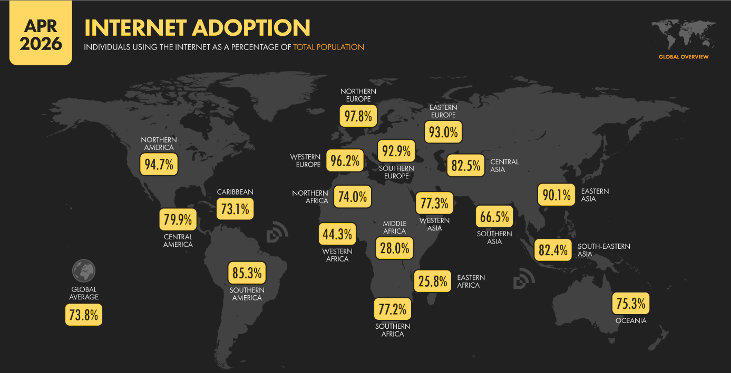
APRIL 2026
Internet Adoption
INTERNET USERS AS A PERCENTAGE OF TOTAL POPULATION
Global Numbers
SOURCE: DATAREPORTAL - APRIL 2026 GLOBAL STATSHOT
A TELECOM FIJI PRESENTATION | 2026
NATIONAL CONFERENCE ON INFORMATION TECHNOLOGY | FNU

Slide 6





The Pacific Reality
Fiji leads a region that is catching up fast, but the urban-rural gap remains wide
Small Island Developing States: The Connectivity Gap within the Gap
79.4%
of Fiji's population uses the internet (2025)- up from 48% in 2018
84%
URBAN AREAS
8.4%
34%
RURAL AREAS
annual growth in internet use across Pacific SIDS (2014–23), outpacing the 6.7% global rate
A 50-point gap between city and village internet use — the exact challenge fibre, 5G, and satellite together must close.
SOURCE: DATAREPORTAL, DIGITAL 2025: FIJI; APNIC BLOG, “FIJI'S STRENGTHENING INTERNET INFRASTRUCTURE” (JUN 2025), CITING ITU; UNCTAD DIGITAL ECONOMY REPORT – PACIFIC EDITION 2024, VIA FBC NEWS; ITU, MEASURING DIGITAL DEVELOPMENT: FACTS & FIGURES 2025.
A TELECOM FIJI PRESENTATION | 2026
NATIONAL CONFERENCE ON INFORMATION TECHNOLOGY | FNU

Slide 7
What's Driving the Surge
Four forces are pushing global traffic higher every year, and reshaping what networks must carry
Video & Streaming
Social Media
AI & Automation
Digitisation
Video makes up roughly 60–70% of downstream global traffic. YouTube alone averages about 1.5 GB per user, per day.
Communication and social platforms account for close to a quarter of all global internet activity today.
Cisco projects AI could grow consumer-driven network traffic roughly 6.6x by the mid-2030s, led by always-on AI.
Banks, government, educators, and business are moving online by default, turning access into infrastructure.
SOURCE: : APPLOGIC NETWORKS (FORMERLY SANDVINE), 2025 GLOBAL INTERNET PHENOMENA REPORT; SQ MAGAZINE, 2026 INTERNET STATISTICS; CISCO, AI IMPACT ON WIDE AREA NETWORKS REPORT (2026).
A TELECOM FIJI PRESENTATION | 2026
NATIONAL CONFERENCE ON INFORMATION TECHNOLOGY | FNU

Slide 8

Connectivity with Telecom Fiji
“We believe that connectivity is a fundamental human right.”
– Sundar Pichai, CEO of Alphabet and Google
  The telecommunications sector has experienced significant technological advances, with global growth in mobility, broadband, and internet services.
  Telecom Fiji has heavily invested in expanding network coverage through fiber, 5G, and satellite, improving connectivity, especially in rural areas.
  Telecom Fiji is driving digital transformation in the country by offering robust solutions via the cloud to support businesses and individuals.
  Through advanced technologies and reliable connectivity, Telecom Fiji is contributing to a more connected and digitally empowered Fiji.
A TELECOM FIJI PRESENTATION | 2026
NATIONAL CONFERENCE ON INFORMATION TECHNOLOGY | FNU

Slide 9



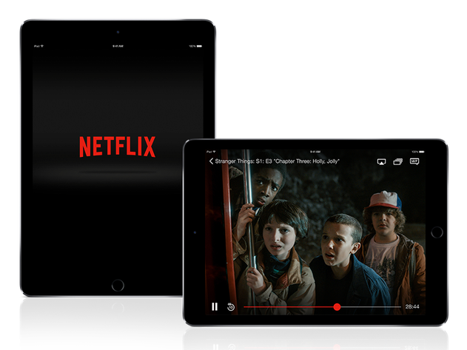

Application Traffic Today
Connectivity has been the driving force behind the surge in traffic to various online platforms.
The stats below showcase the bandwidth of popular applications used today.
Web Browsing (HTTPS)
YouTube
2.57 Gbps
3.35 Gbps
Average of Mar-Jul, 2026
Average of Mar-Jul, 2026
Facebook
1.71 Gbps
Average of Mar-Jul, 2026
Netflix
2.60 Gbps
TikTok
1.86 Gbps
Average of Mar-Jul, 2026
Average of Mar-Jul, 2026
A TELECOM FIJI PRESENTATION | 2026
NATIONAL CONFERENCE ON INFORMATION TECHNOLOGY | FNU

Slide 10







AI Traffic Race: Claude, ChatGPT & Copilot
Connectivity has been the driving force behind the surge in traffic to AI platforms. The stats below showcase the bandwidth of leading AI services used today. Claude, ChatGPT, and Copilot currently carry 98% of all AI traffic.
Claude
Copilot
2,637 GB
2,363 GB
+109% Mar-to-July, 2026
+19% Mar-to-July, 2026
ChatGPT
Others (Gemini, Grok, DeepSeek)
2,638 GB
140 GB combined
+4% Mar-to-July, 2026
Under 2% of total AI traffic, Mar-to-July, 2026
A TELECOM FIJI PRESENTATION | 2026
NATIONAL CONFERENCE ON INFORMATION TECHNOLOGY | FNU

Slide 11
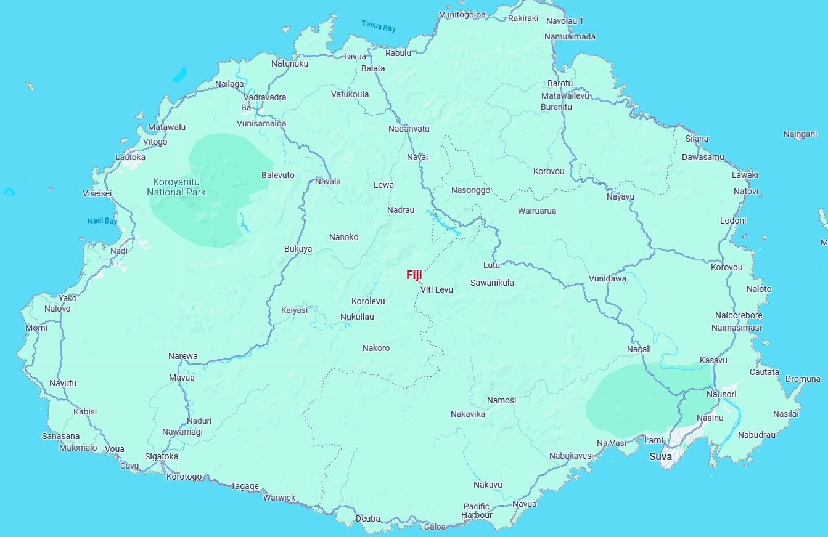

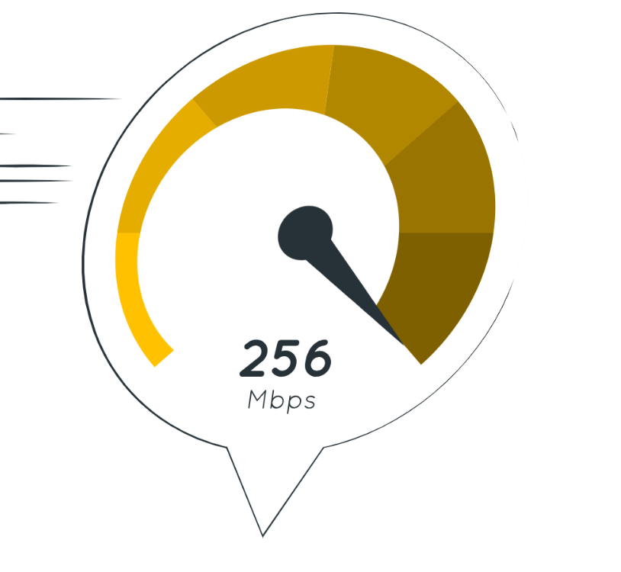


The National Network
Telecom Fiji hosts a robust IP/MPLS network core, which operates at 100G capacity. This national-level infrastructure is the backbone for connectivity across Fiji, ensuring reliable data transmission and supporting the nation's digital economy.
100
Gbps
A TELECOM FIJI PRESENTATION | 2026
NATIONAL CONFERENCE ON INFORMATION TECHNOLOGY | FNU

Slide 12
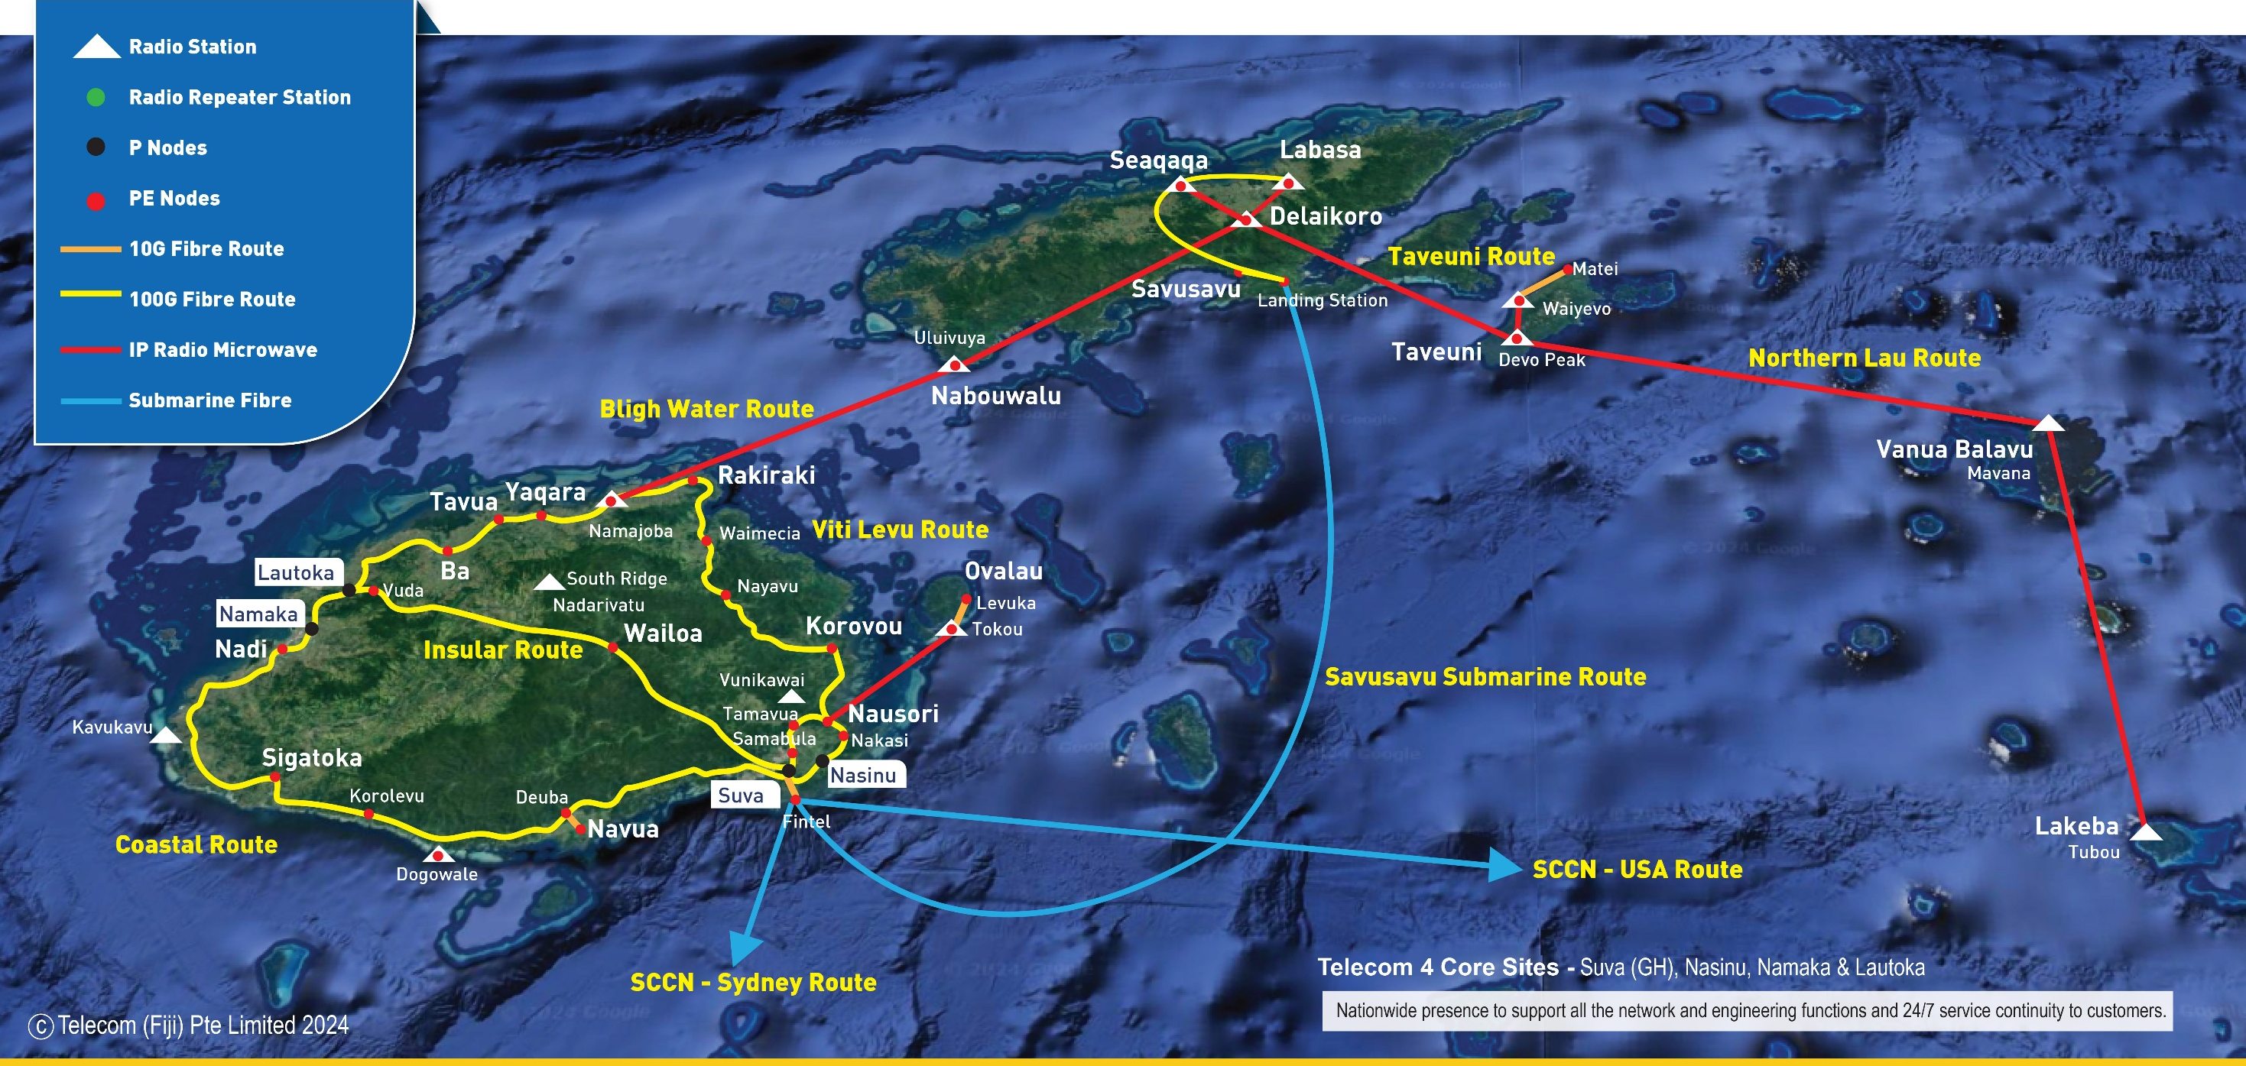
Backbone for the Digital Economy
  Telecom Fiji's national infrastructure forms the foundation of Fiji's digital economy.
  This extensive network provides essential connectivity for businesses, individuals, and institutions to access digital services.
  The infrastructure's reliability and capacity are crucial for supporting Fiji's economic growth and development.
A TELECOM FIJI PRESENTATION | 2026
NATIONAL CONFERENCE ON INFORMATION TECHNOLOGY | FNU

Slide 13
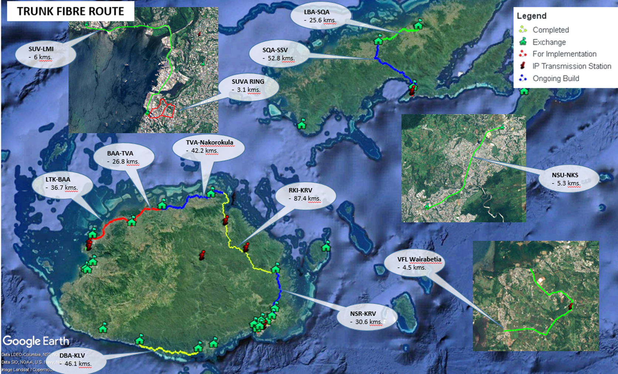
Constantly Growing Infrastructure
  Telecom Fiji is implementing fiber projects across Viti Levu and expanding its network to Vanua Levu.
  The company is deploying 10GPON technology to provide fibre-to-the-home (FTTH) infrastructure for high-speed internet access.
  Telecom Fiji is planning new areas for FTTH deployment to improve connectivity throughout Fiji.
A TELECOM FIJI PRESENTATION | 2026
NATIONAL CONFERENCE ON INFORMATION TECHNOLOGY | FNU

Slide 14
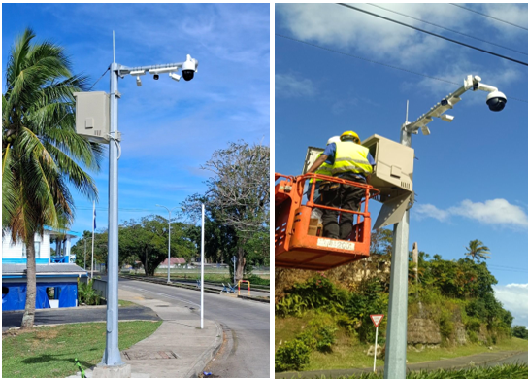
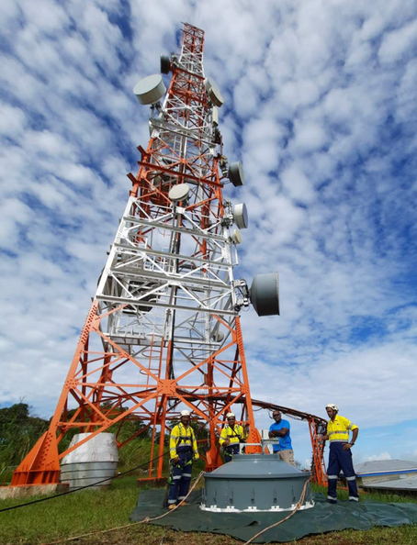
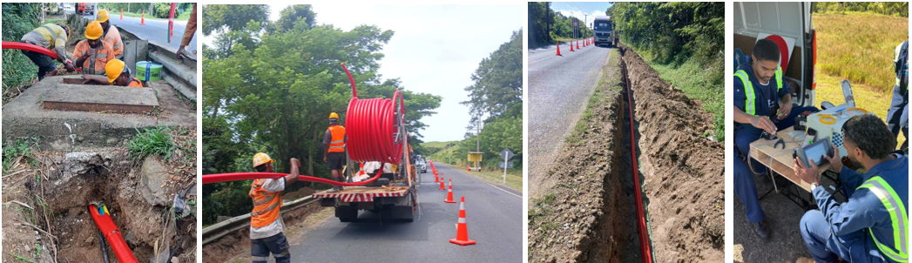
Building Next-Gen Networks
  5G technology provides faster speeds, lower latency, and greater capacity, and Telecom Fiji is investing in infrastructure to deliver a superior 5G experience.
  Google Terrestrial Fibre Project, linking the FINTEL and Natadola Cable Landing Stations through a resilient terrestrial fibre backbone.
A TELECOM FIJI PRESENTATION | 2026
NATIONAL CONFERENCE ON INFORMATION TECHNOLOGY | FNU

Slide 15
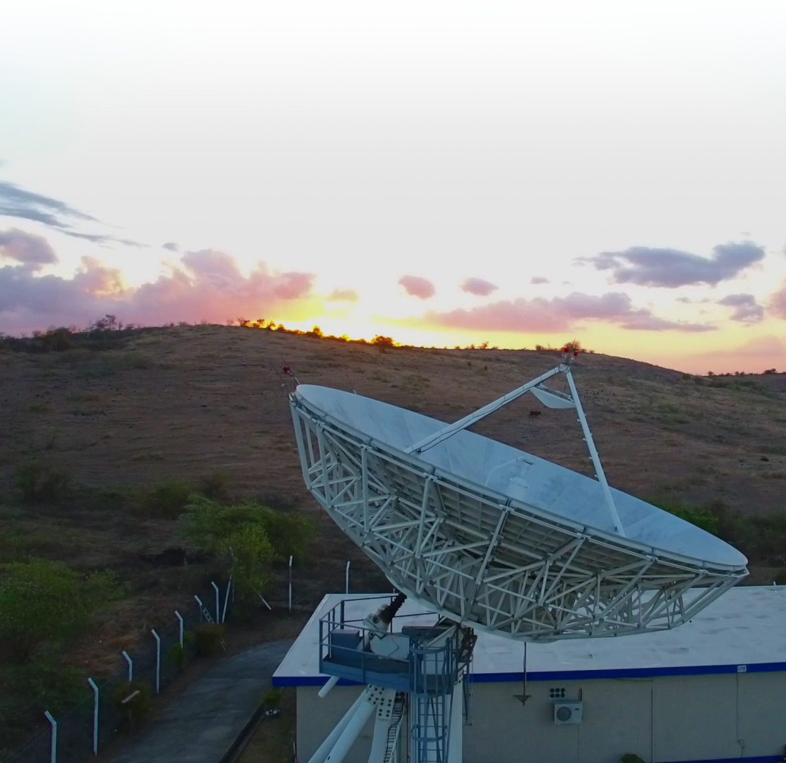
Going Further with Satellite
2004
2006
2017
Hub was officially opened by Late Hon. Mr Laisenia Qarase
Agreement was signed with Gilat to upgrade the Hub to “Sky Edge 1”
The Hub was upgraded to “Sky Edge 2”. Improving existing capabilities
  The Yaqara Satellite Hub has been a key part of Telecom Fiji's network infrastructure, providing essential connectivity for over 20 years.
  It has played a crucial role in bridging the digital divide, ensuring reliable communication, especially in remote areas of Fiji.
  Telecom Fiji uses the hub to offer satellite-based solutions such as broadband internet, telephony, and data services across the country.
2020
Partnership was formed with Kacific to strengthen Telecom Fiji’s satellite offering capacity.
2024
Telecom Fiji became authorised resellers for the Starlink satellite portfolio.
2026
Decommissioning of Yaqara Hub
A TELECOM FIJI PRESENTATION | 2026
NATIONAL CONFERENCE ON INFORMATION TECHNOLOGY | FNU

Slide 16



No Village Left Behind: Universal Service in Action
Telecom Fiji's USO rollout is turning satellite connectivity into community-owned access
Starlink-powered managed Wi-Fi, delivered through a voucher-based access model. Selected villagers are trained to manage and sell vouchers, and local youth are trained as first responders for basic troubleshooting — keeping access sustainable, affordable, and community-owned.
240
villages identified with poor or no connectivity nationwide
126
sites in Phase One — 30 delivered by Telecom Fiji across Namosi, Navosa & Lomaiviti
“Access to digital services is no longer a luxury but a necessity for education, health services, business development, and staying connected with loved ones.”
— Hon. Ioane Naivalurua, Minister for Policing and Communications
11,000+
Fijians set to benefit directly from Phase One alone
SOURCE: TELECOM FIJI LIMITED, “USO CONTRACT TO CONNECT RURAL AND MARITIME COMMUNITIES” PRESS RELEASE; FIJI SUN, “NAMOSI VILLAGE CONNECTED THROUGH STARLINK” (JAN 2026); THE FIJI TIMES, “RURAL CONNECTIVITY” (AUG 2025); DEVELOPING TELECOMS (JAN 2026).
A TELECOM FIJI PRESENTATION | 2026
NATIONAL CONFERENCE ON INFORMATION TECHNOLOGY | FNU

Slide 17
"Each and every one of us is operating right now on the front lines of a war that is never going to be cleared."
Securing Our Connections Today
— Nick Andersen, Executive Assistant Director for Cybersecurity, CISA
  The growing complexity of networks and evolving threats make network resilience a top priority.
  A resilient network can withstand and recover from disruptions, attacks, or failures, minimizing downtime and ensuring continuous operations.
  Increased reliance on digital platforms exposes individuals and organizations to greater cybersecurity risks.
  Malicious hackers exploit security vulnerabilities to access personal data and capitalize on organizations' expanding digital footprints.
Fast Facts
Around the world, a data breach cost $4.44 million on average in 2025, down 9% from the year before as AI-driven detection sped up containment.
Phishing remains the most common attack vector, present in around 16% of breaches, with roughly 3.4 billion phishing emails sent worldwide every day.
Over 90% of cyberattacks begin with a phishing email as the initial entry point, according to CISA.
The average breach now takes 241 days to identify and contain, the fastest response time in nine years.
SOURCE: DEEPSTRIKE.IO, IBM.COM, HELPNETSECURITY.COM, GETASTRA.COM
A TELECOM FIJI PRESENTATION | 2026
NATIONAL CONFERENCE ON INFORMATION TECHNOLOGY | FNU

Slide 18


Fostering Secure and a Resilient Future
NETSAFE
BUILT-IN PROTECTION FOR
EVERY CONNECTED FIJIAN
  Telecom Fiji has formed a strategic partnership with Allot to enhance its network security capabilities and protect customers from cyber threats.
  Telecom NetSafe proactively detects and prevents various cyberattacks, such as malware, phishing, and DDoS, using advanced threat intelligence and behavioral analytics.
  This partnership will benefit customers by providing a more secure network experience, safeguarding sensitive data, protecting privacy, and ensuring business continuity by minimizing downtime.
Telecom NetSafe is a network-based cybersecurity service that protects every connected device — no hardware, no software, no technical setup required.
As more Fijian homes, schools and SMEs come online, NetSafe closes the security gap automatically — protection that scales with digital access, not after it.
A TELECOM FIJI PRESENTATION | 2026
NATIONAL CONFERENCE ON INFORMATION TECHNOLOGY | FNU

Slide 19

The Future of Connectivity
"Networks are outgrowing the humans who run them."
01
02
Hyperconnectivity
Sustainable Networks
– from HCT Group's 2026 CEO's Guide to AI-Driven Network Operations
5G-Advanced is now paving the way toward 6G, with 3GPP targeting mid-2027 for the first 6G specifications and commercial rollout expected around 2030. This next phase promises faster speeds, lower latency, and AI-native network design from the ground up.
Energy-efficient equipment, reduced e-waste, and renewable-powered infrastructure remain central to network planning, with AI-driven energy management now emerging as a key tool operators use to cut power consumption as network complexity grows.
  The connectivity landscape is rapidly evolving due to technological advancements, changing consumer demands, and global trends, accelerating the pace of change.
  Future trends are leading to more pervasive, intelligent, and sustainable connectivity, creating vast opportunities for innovation and growth for organizations and individuals.
03
04
Edge Computing
AI and Automation
Edge computing processes data closer to its source, cutting latency and improving performance for real-time applications. It remains a foundational building block for the low-latency demands of 5G-Advanced and future 6G services.
AI adoption in telecom jumped from 49% to 66% of the industry within a single year. Operators like Bharti Airtel report 30-50% faster fault repair and 20-25% lower operating costs after deploying agentic AI to manage network operations.
A TELECOM FIJI PRESENTATION | 2026
NATIONAL CONFERENCE ON INFORMATION TECHNOLOGY | FNU

Slide 20
Thank You for your time.
A TELECOM FIJI PRESENTATION | 2026
NATIONAL CONFERENCE ON INFORMATION TECHNOLOGY | FNU

